Slide 1
Antimalarial Toxicity 2020
SLE Meeting November 17, 2020
Michael Easterbrook, MD FRCS(C), FACS
Professor of Ophthalmology,
University of Toronto

Slide 2
Are Antimalarials Safe?
122 patients, 20 or more years of use…
Hydroxychloroquine 111
Chloroquine alone 5
Chloroquine, then Hydroxy. 6
Only one patient developed retinopathy!

Slide 3
Purpose
• Review tests for macular toxicity
• Suggest guidelines for screening patients on anti-malarials.

Slide 4
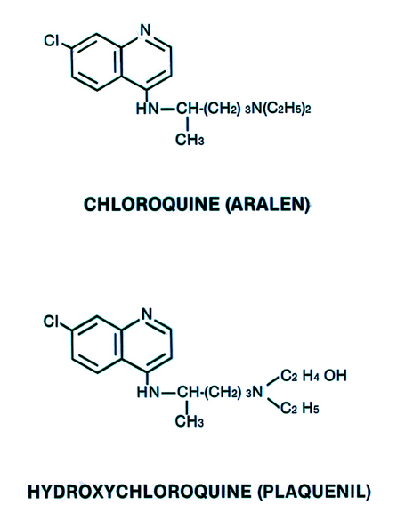

Slide 5
Tests Useful in Diagnosing Early Retinopathy
1. Visual acuity
2. Color vision
3. Slit lamp examination -dilated pupil
4. Field tests: • Amsler
• 10-2 Humphrey: red and white
5. Fundus examination
6. OCT and autofluorescence
7. Multifocal ERG

Slide 6
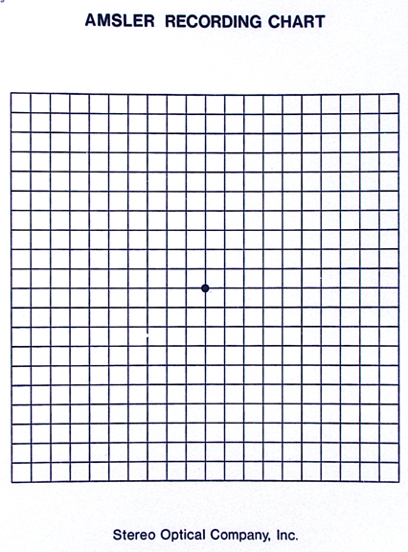

Slide 7
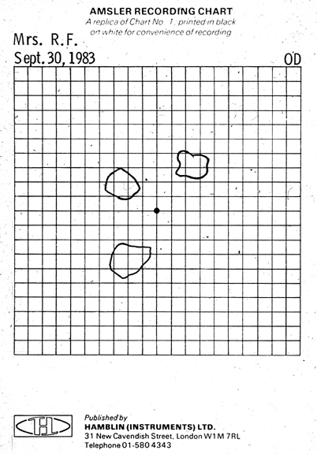

Slide 8
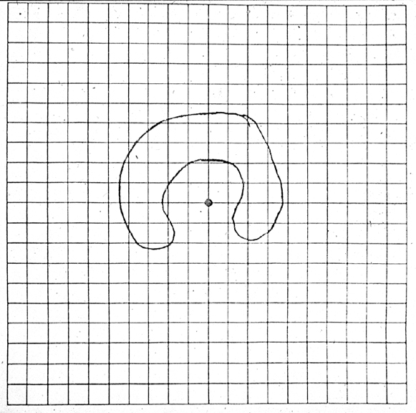

Slide 9
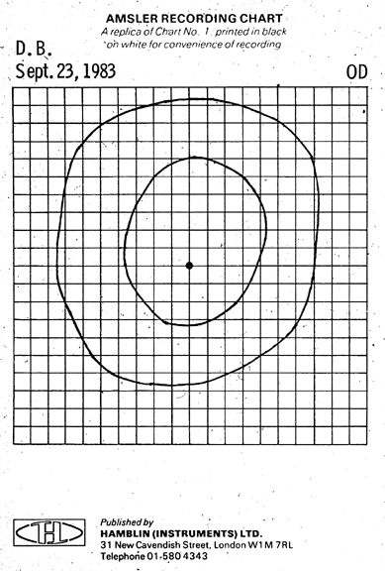

Slide 10
Objective Diagnostic Tests
• Multifocal ERG
• Autofluorescence
• OCT

Slide 11
Multifocal ERG
• Sensitivity
• Specificity
• Cost
• Comfort: contact lens or filaments

Slide 12
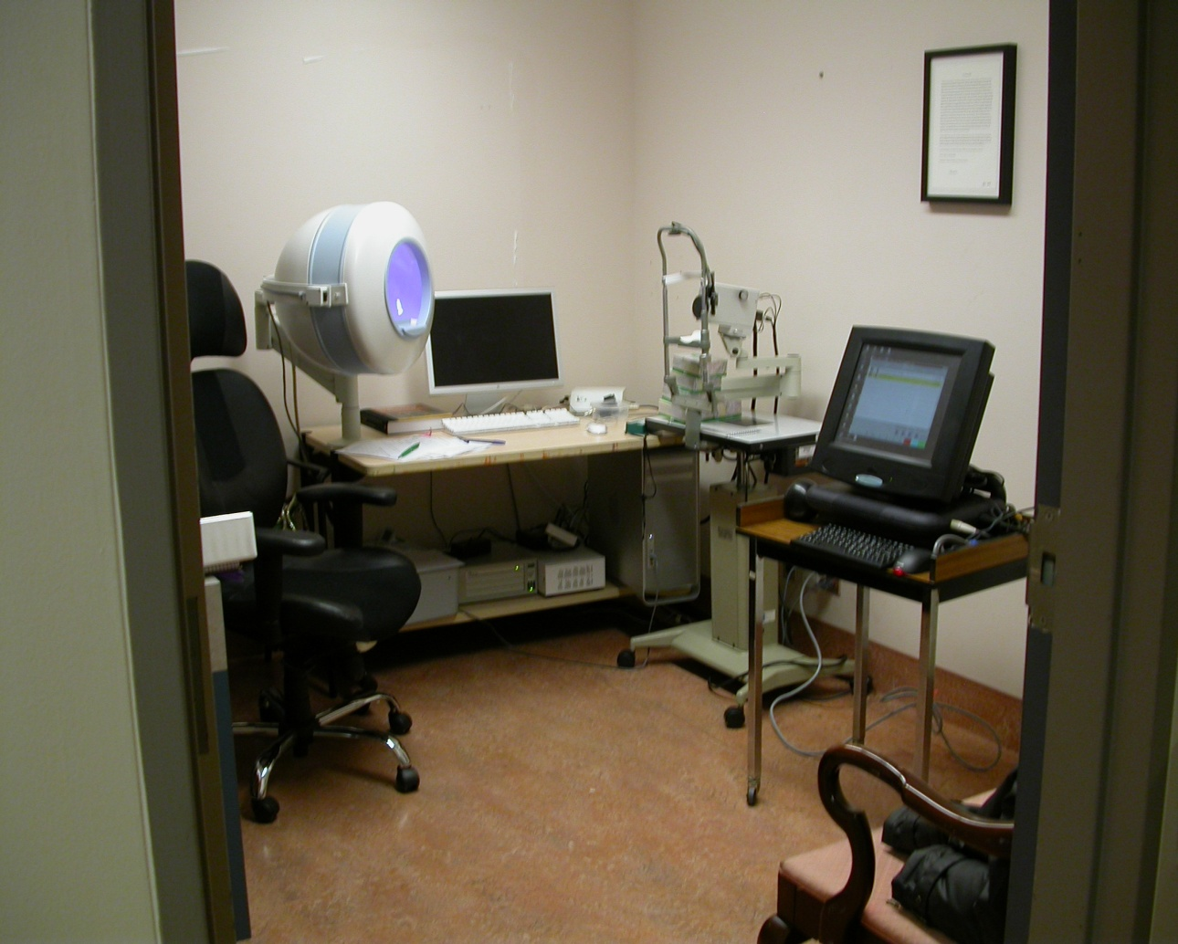
Full-field
GANZFELD
Multi-focal
SCREEN-BASED

Slide 13
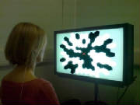

Slide 14
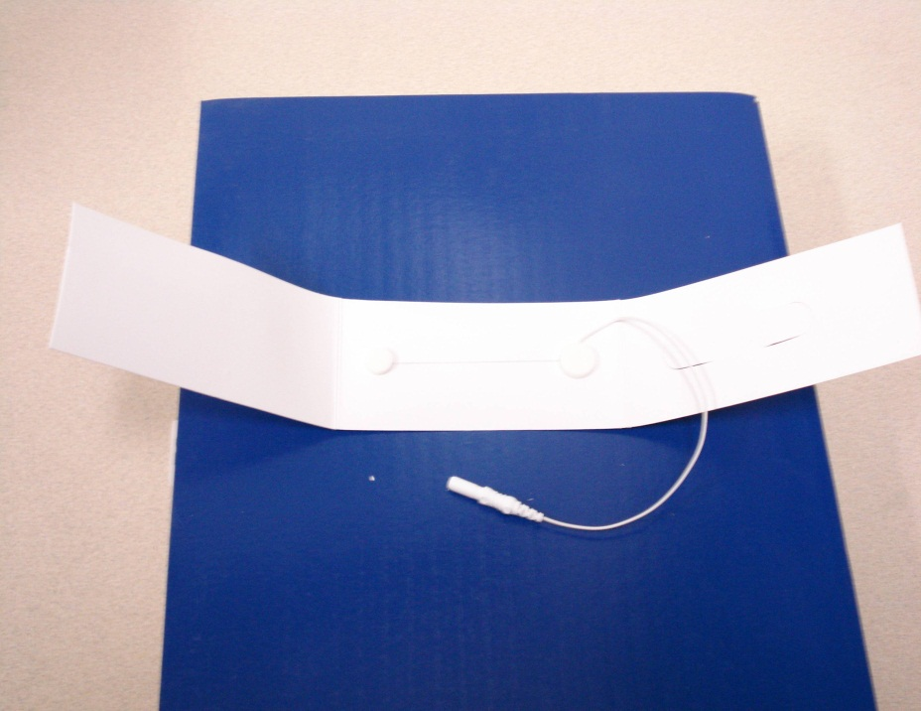
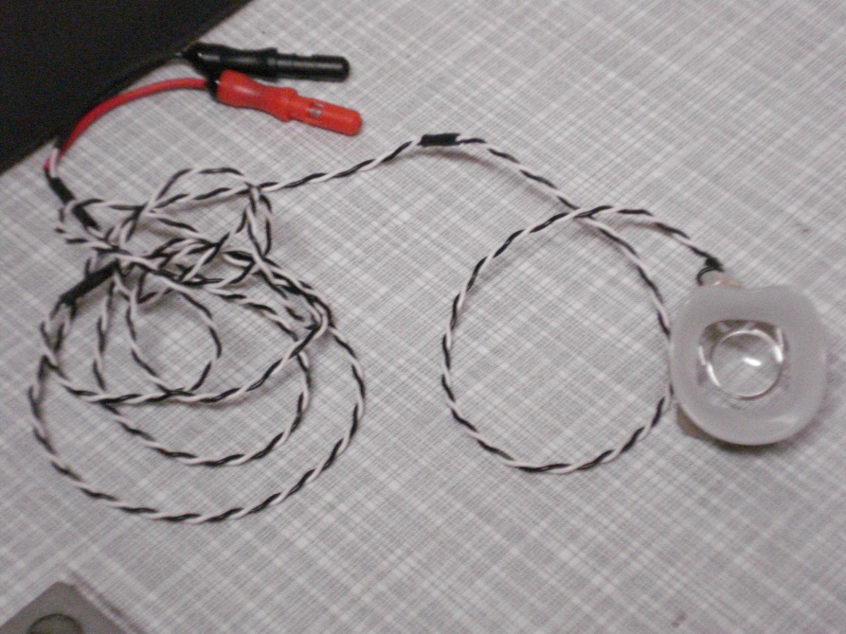
Fibre
Adhesive pads
DTL electrode
Burian Allen electrode
Arrows point to fine fibre that is placed across inferior lid margin touching conjunctiva

Slide 15
Normal mfERG topographic map

Slide 16
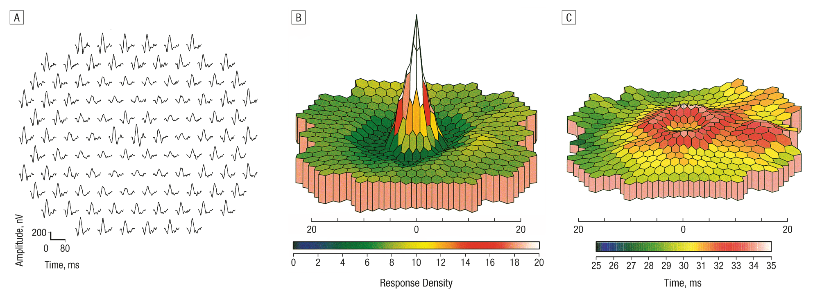
Preservation of central peaks
Relative depression in surrounding rings
Multifocal Electroretinographic Evaluation of Long-term HydroxychloroquineUsers
Raj K. Maturi et al
Arch Ophthalmol. 2004;122(7):973-981. doi:10.1001/archopht.122.7.973

Slide 17
More advanced cases
Abnormal mfERG topographic map
Central (foveal) peak relatively preserved, with notably depression in surround rings (2 & 3)
In this patient, there is also significant foveal involvement

Slide 18
OCT
• Becoming readily available
• Increasing resolution
• In advanced cases, reduced thickness of outer nuclear layer, layer of outer segments and layer of the photoreceptor/outer segment junction

Slide 19
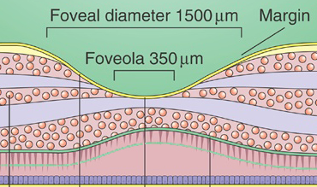
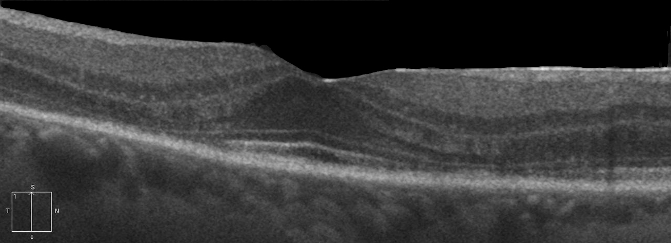
SD-OCT
Outer nuclear Layer
ONL
External limiting membrane
ELM
junction inner/ outer segment
IS/OS
ONL
ELM
IS
OS
junction inner/ outer segment defect
junction inner/ outer segment
junction inner/ outer segment defect

Slide 20
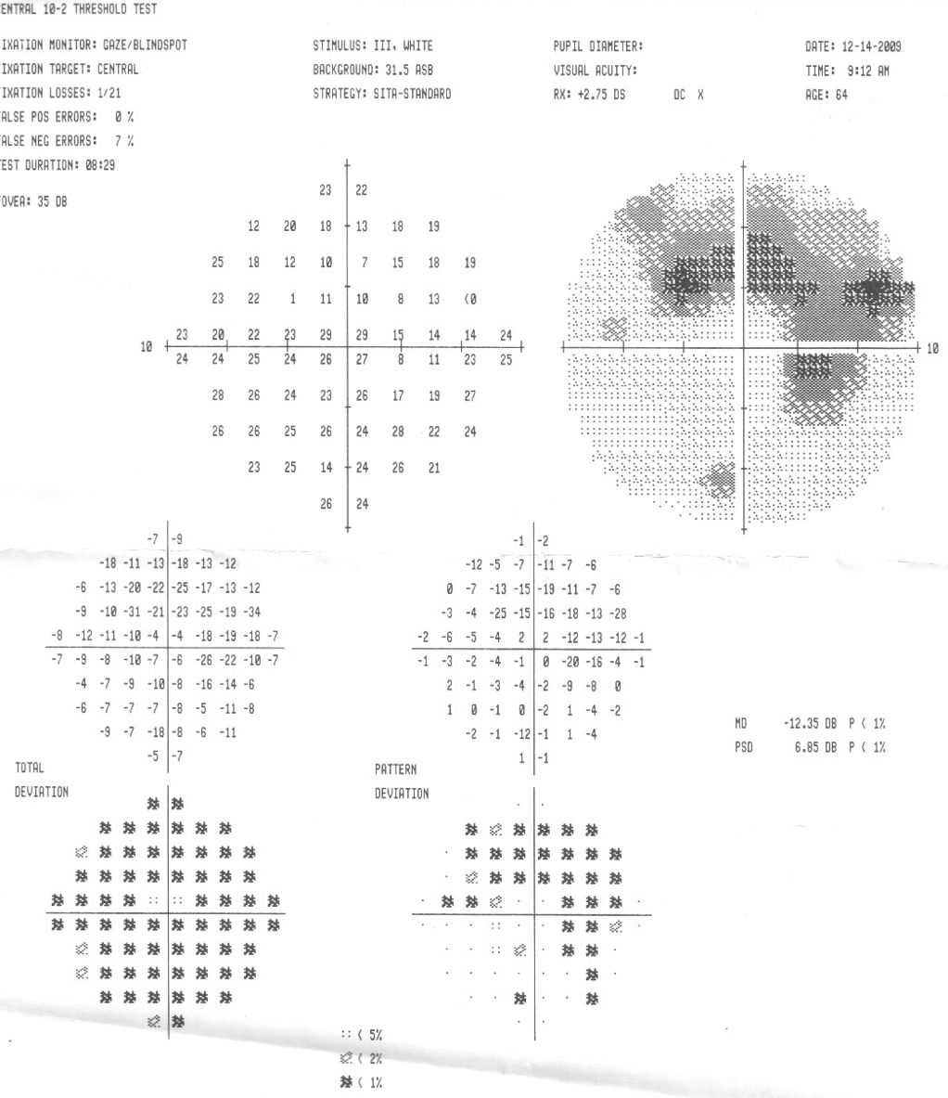
SD-OCT
ONL
ELM
IS
OS

Slide 21
Color Vision Testing is Useful
• number of plates
• speed of recognition
• significant loss is associated with advanced retinopathy and progressive course

Slide 22
Early Retinopathy
1. Bilateral, reproducible, relative field defects,
Amsler, and Humphrey 10-2 positive
2. Asymptomatic
3. Normal vision
4. Normal color vision
5. Normal fundus
6. Does not progress upon cessation of drug

Slide 23
Screening Recommendations
Baseline exam in first year
• visual acuity
• color
• retina: dilate pupils
• Amsler and/or 10-2 Humphrey

Slide 24
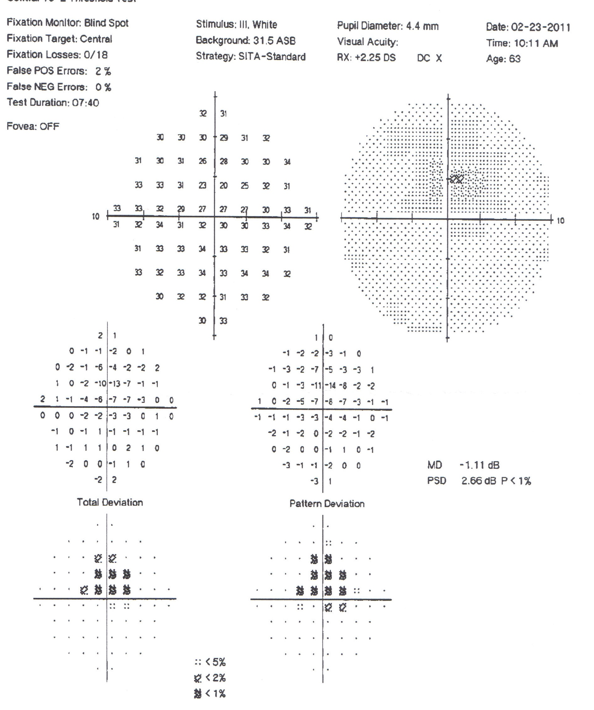
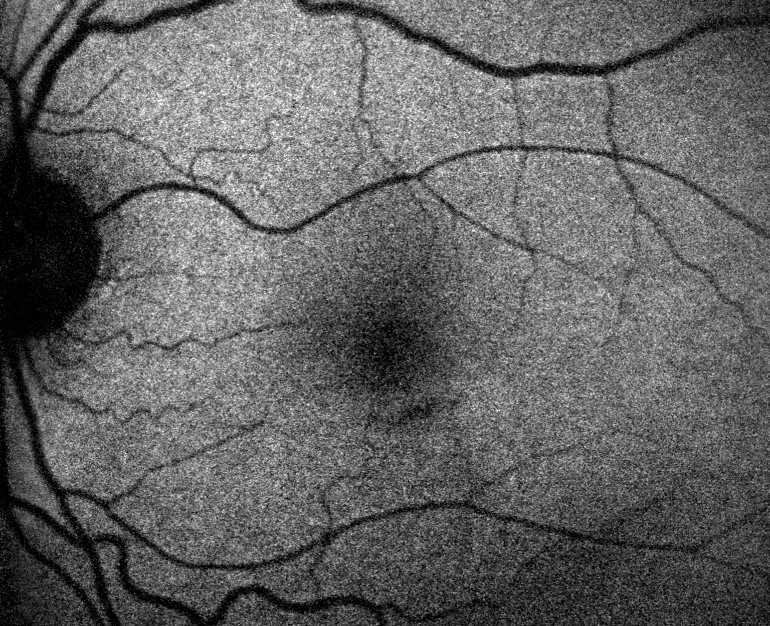
OCT, autofluorescence, mfERG in the diagnosis of anti-malarial toxicity
Case 1 – Left eye
10-2 HVF
Autofluorescence

Slide 25
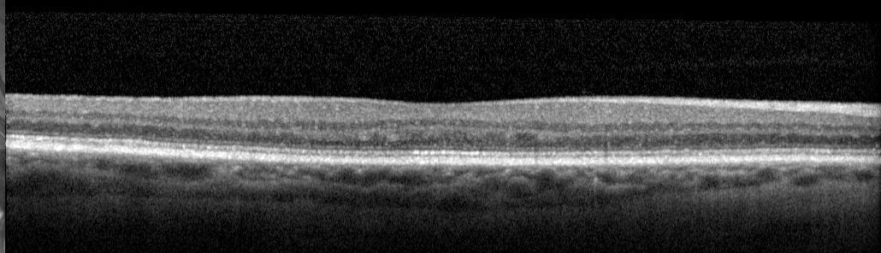
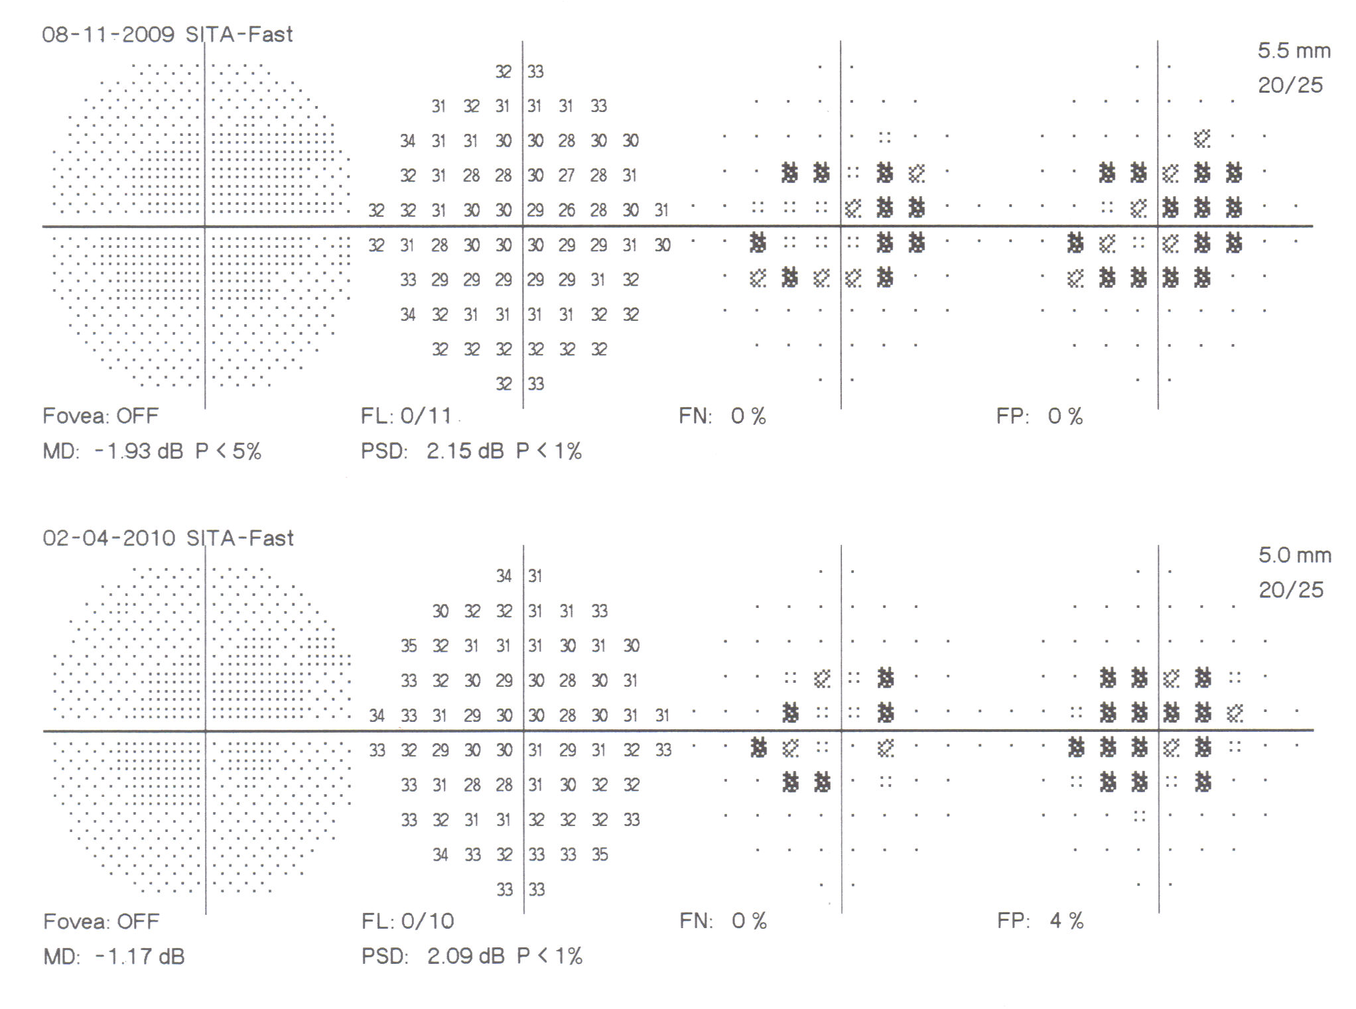
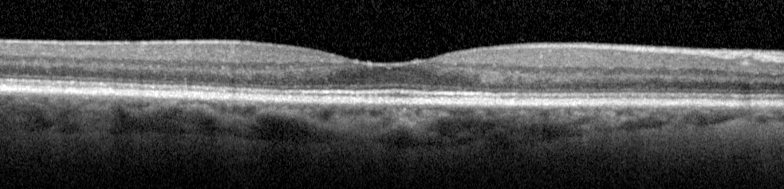
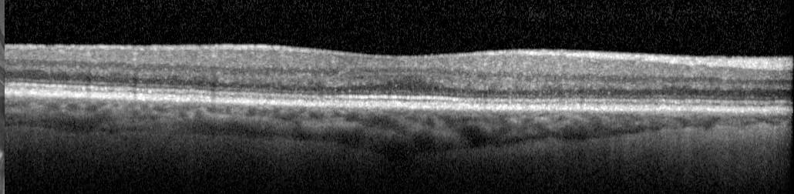
OCT, autofluorescence, mfERG in the diagnosis of anti-malarial toxicity
Case 2– Right eye
10-2 HVF
SD-OCT Spectralis

Slide 26
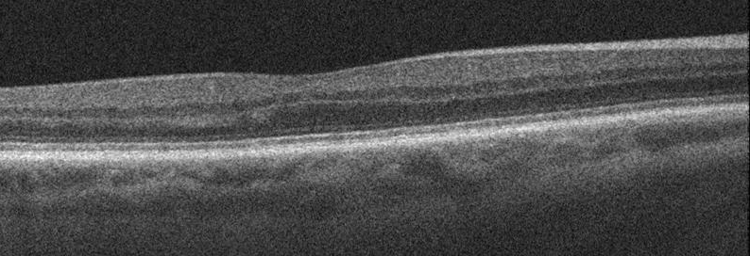
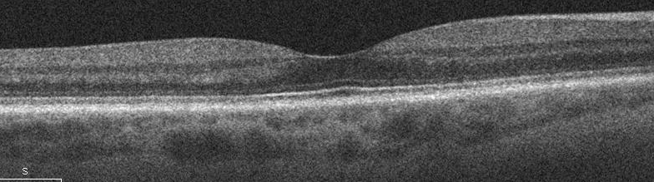
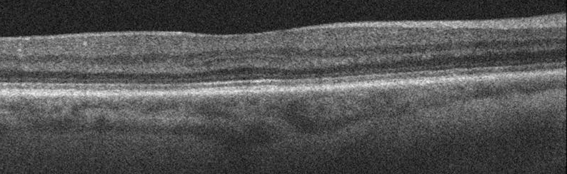
Case 2 – Right eye
OCT, autofluorescence, mfERG in the diagnosis of anti-malarial toxicity
10-2 HVF
SD-OCT Cirrus

Slide 27
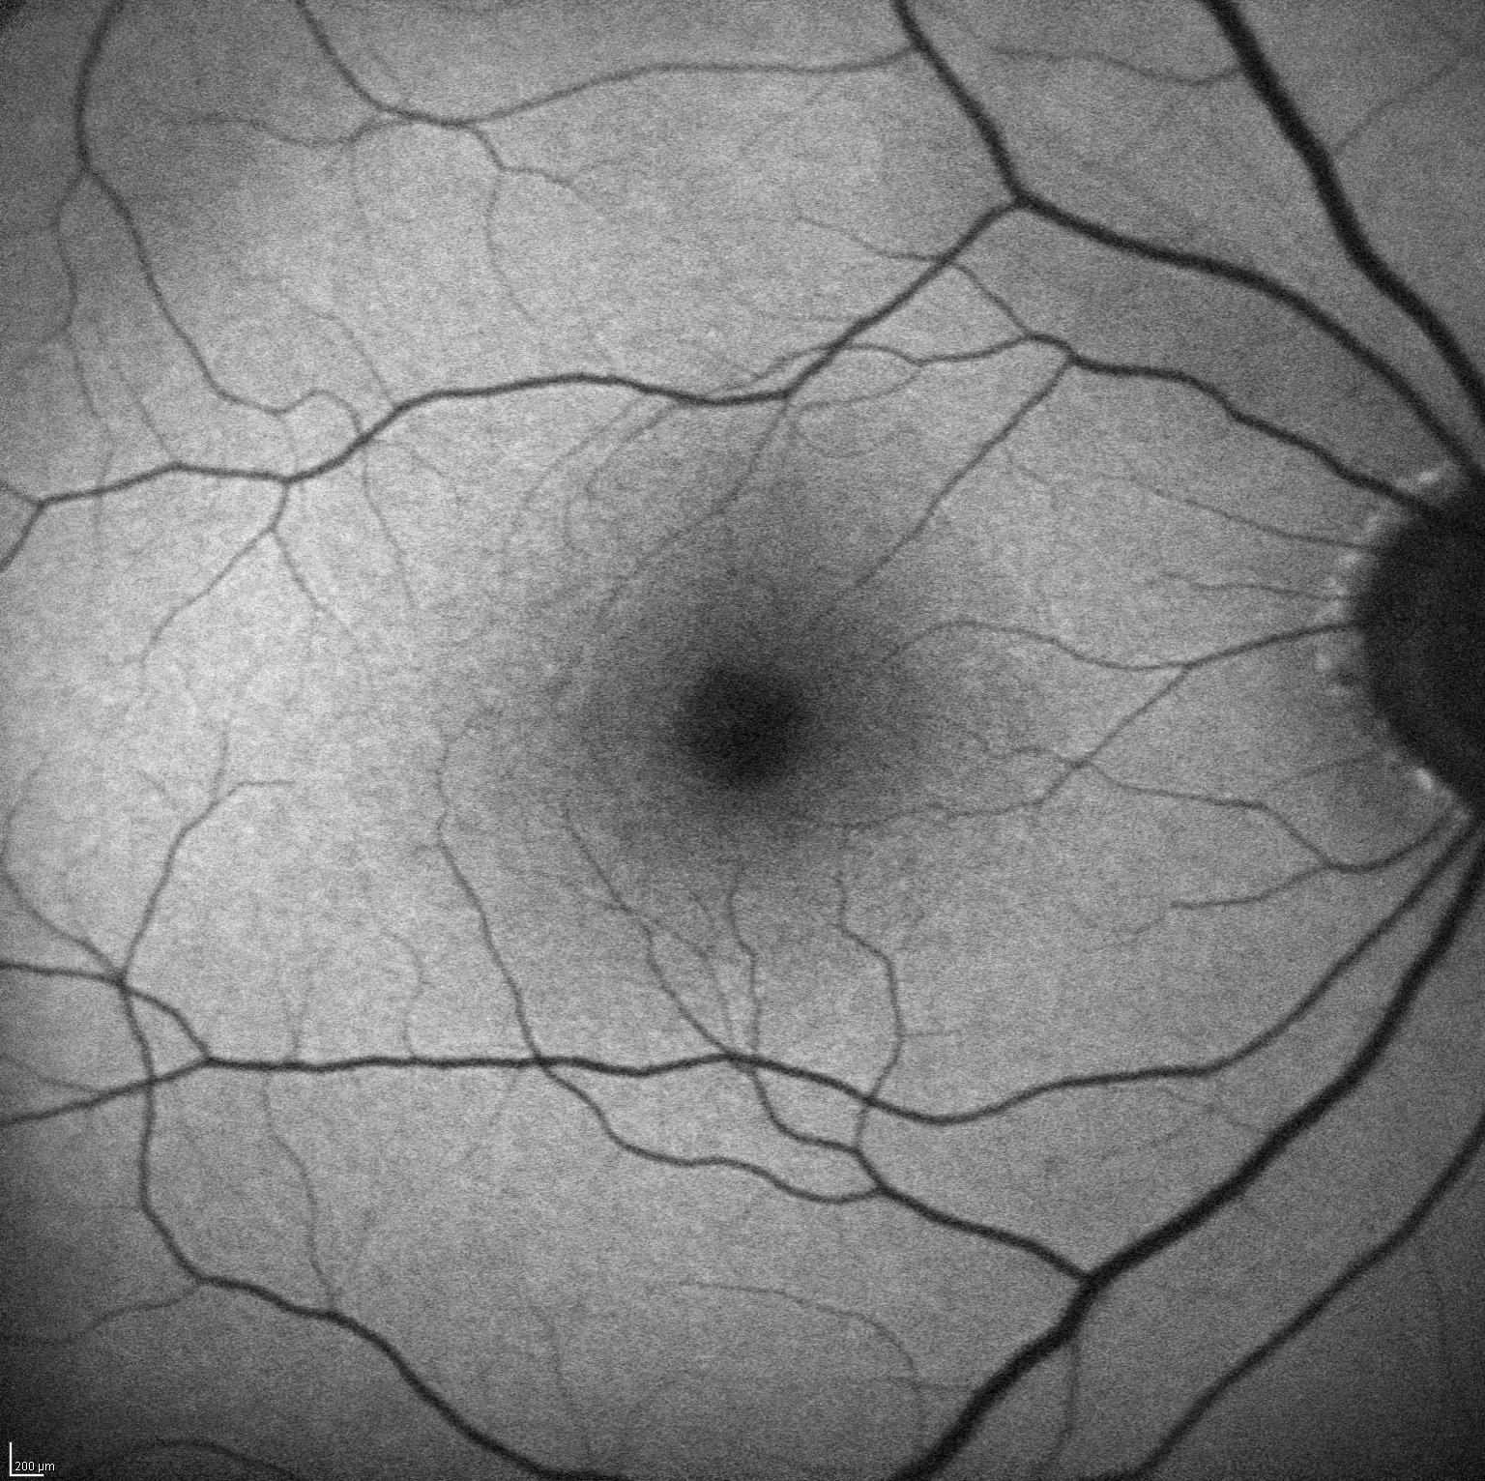
Case 2 – Right eye
OCT, autofluorescence, mfERG in the diagnosis of anti-malarial toxicity
Autofluorescence
10-2 HVF

Slide 28
Low Risk Patients
Dosage Hydroxychloroquine < 6.5 mg/kgm/day
Chloroquine < 3 mg/kgm/day
Duration < 5 years
Habitus lean
Renal/Liver Disease none
Concurrent Retinal Disease none
Age < 60

Slide 29
Low Risk Patients
• < 40 years of age: q 5 years
• > 40 years of age: q 2 years
• > 60 years of age: q 1 year
Only 1 case of retinopathy reported less than 5 years at 6.5 mg/kgm or less

Slide 30
High Risk Patients
Dosage Hydroxychloroquine > 6.5 mg/kgm/day Chloroquine > 3 mg/kgm/day
Duration > 5 years
Habitus high body fat
Renal/Liver Disease present
Concurrent Retinal Disease present
Age > 60

Slide 31
Ideal Body Weight
Obvious
What you weighed when you finished high school
What you weighed when you married the first time
Males: 100 lbs. + 7 lbs. per each inch over 5 feet tall
Females: 100 lbs. + 5 lbs. per each inch over 5 feet tall

Slide 32
Ideal vs Real Body Weight
AAO 2011 guidelines- “Antimalarials not retained in fatty tissues, so obese patients will be seriously overdosed if dose on real body weight. Obese: ideal body weight.”
AAO 2016 guidelines: “concentration of these drugs low in fat.” “ All patients-daily less than 5 mgms/kgm Real Body Weight!

Slide 33
Overweight and Obesity
CDC: Obesity – BMI 30 and over
Age 20-39: 35.7% age 40 -59: 42.8% age over 60: 41% Hispanics, blacks (47%)
Overweight: BMI 25-30: 30+%
2 of 3 adults are overweight or obese!

Slide 34
Ideal vs Real Body Weight
190 (86 kgm RBW) (52 kgm IBW) 5 foot 3 inch (160 cms) SLE patient on 400 mgms hydroxychloroquine per day
Maximum dose real weight @ 5 mgms/ kgm=430 mgms
Maximum dose ideal weight @ 6.5 kgms/kgm= 340 mgms
We will be overdosing small obese patients if we use real weight......

Slide 35
400 Mgms Daily Dose
If a female patient is less than 5 foot 7 inches, 400 mgms is at the top of her dose.
Latest AAO guidelines at 5 mgms/kgms Real Body Weight (RBW) will overdose short patients- use IBW(ideal body weight)

Slide 36
Are Antimalarials Safe?
122 patients, 20 or more years of use…
Hydroxychloroquine 111
Chloroquine alone 5
Chloroquine, then Hydroxy. 6
Only one patient developed retinopathy!

Slide 37
Conclusion
Hydroxychloroquine is safe with proper dose and monitoring.
Early retinopathy does not progress and is associated with 20/20 vision.
Retinopathy can be detected early.
RBW dosage ok for adult- but-
Ideal body weight if short and/or overweight, obese.

