Slide 1
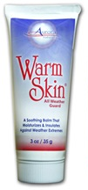
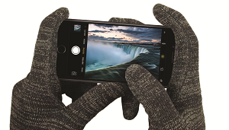
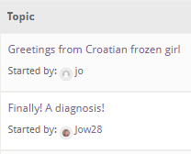
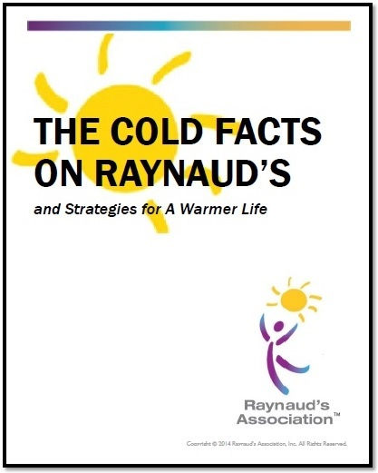
Support Services
Cold Cuts Newsletter
Toll-Free Hotline
Discussion Forum: Connect with 14,000 Global Frosties
First Alert on Research and New Products
Educational Materials
Member Discounts on Warming Products
Social Media Communities Facebook Twitter Pinterest Instagram
Informative “In the News” Blog
Raynaud’s Awareness Month

Slide 2
Understanding Raynaud’s Attacks:
Autonomic Nervous System
Sympathetic Nervous System
(Fight or Flight response)
Physical responses built into the body to prepare it to engage a threat or run away
Symptoms: Increased heart rate, pupils dilate, veins in skin constrict to send more blood to the core to protect vital organs - less blood in the extremities to keep them warm, blood sugar levels increase, hormones levels increase, etc.

Slide 3
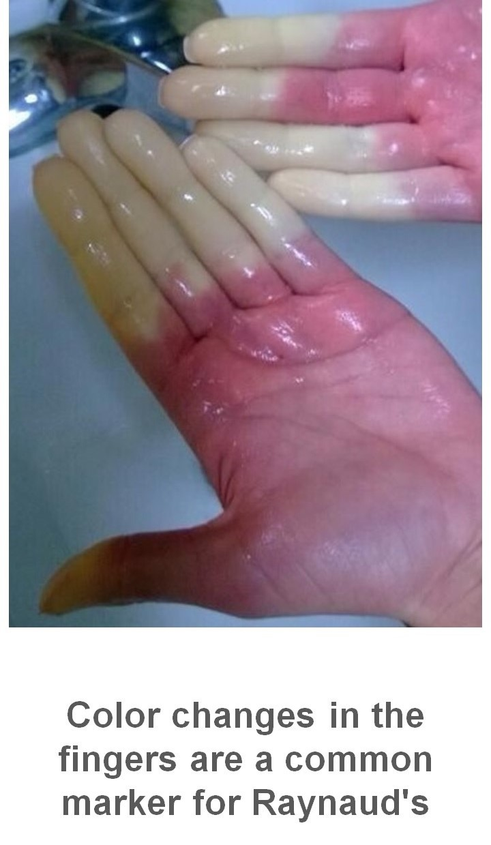
Raynaud’s Syndrome
An exaggerated version of the “Fight and Flight” response where you visually see color changes demonstrating blood flow into and out of the extremities due to spasms of blood vessels in the extremities
Common triad of color changes in the extremities- white as the the blood flows out of the digits, blue from the lack of oxygen, then red as the blood flows back to normal
Milder attack white. More severe purple to greyish black. Mottled pinkish/red pattern

Slide 4
10 Myths
About Raynaud’s Phenomenon
Copyright © 2021 Raynaud’s Association, Inc.

Slide 5
Myth #1: Raynaud’s is a rare disease
5% -10% of US population (15M to 30M)
1/10 aware that they have it
Copyright © 2021 Raynaud’s Association, Inc.

Slide 6
Myth #2: There is a formal test to diagnose Raynaud’s
No formal test
Diagnosis is based on symptoms and testing to trigger attacks (thermal imaging, cold water trigger test)
Secondary raynaud’s testing- nailfold capillaroscopy, anti-nuclear antibody blood test
Copyright © 2021 Raynaud’s Association, Inc.

Slide 7
Myth #3: Raynaud”s affects only fingers and toes
Can affect any extremity (ears, nose, tongue, breast and even sex organs)
Copyright © 2021 Raynaud’s Association, Inc.

Slide 8
Myth #4: Raynaud’s sufferers have “poor circulation”
90% normal vascular functions and circulation
“Fight or flight” response thresholds
Copyright © 2021 Raynaud’s Association, Inc.

Slide 9
Myth #5: Raynaud’s is an allergy to the cold
No
Cold Urticara- rash and itching (red allergic lesions)
Copyright © 2021 Raynaud’s Association, Inc.

Slide 10
Myth #6: Raynaud’s is merely a nuisance, not a medical condition
Primary or secondary raynaud’s – understanding and responding correctly
Misunderstanding from family, friends, etc.
Avoid attacks- temperature changes, stress, lifestyle changes
Copyright © 2021 Raynaud’s Association, Inc.

Slide 11
Myth #7: Raynaud’s episodes always involves the patriotic white, blue, red color changes
Common white, blue red response due to blood flow changes
Milder attack white. More severe purple to greyish black. Mottled pinkish/red pattern
Copyright © 2021 Raynaud’s Association, Inc.

Slide 12
Myth 8#: The only treatment for Raynaud’s is to stay warm
Medication- increase blood flow to the extremities (calcium channel blockers, antibiotics or nitroglycerin paste or patches for ulcers. ED drugs (sildenafil-Viagra vardenafil –Levita, tadalafil –Cialis)
Digital sympathectomy- surgery-more severe cases
Self-help techniques
Natural and holistic remedies not clinically verified
Copyright © 2021 Raynaud’s Association, Inc.

Slide 13
Myth #9: Raynaud’s is only an issue in cold climates/cold seasons
Any exposure to cold (air conditioning, outdoor activities such as swimming, holding a cold glass or reaching into a freezer)
Drastic temperature changes
Stress
Copyright © 2021 Raynaud’s Association, Inc.

Slide 14
Myth #10: Raynaud’s sufferers are likely to lose fingers or toes
Less than 10% have serious conditions that have complications
Secondary conditions- digital ulcers
Manage through avoidance techniques and lifestyle changes
Copyright © 2021 Raynaud’s Association, Inc.

Slide 15
For more information….
Go to www.raynauds.org
Make a donation
Facebook, Twitter, Pinterest, Instagram- talk to other “Frosties”
Copyright © 2021 Raynaud’s Association, Inc.

