Slide 1
VIRTUAL EDUCATION DAY
Fibromyalgia London Group
Helping You Thrive While
Living with Fibromyalgia
Presented by:
Jacqueline Fraser, Founder/Group Mentor
Saturday, November 27, 2021
11:00-12:30pm ET on Zoom

Slide 2
ABOUT FIBROMYALGIA LONDON GROUP
Established November 2014 – now in 8th year of operation
Over the past several years, we have ebbed and flowed, gone through growing pains to become the community-based, volunteer organization we are today.
Evolved from being an in-person support group and London based to a virtual support group for fibromyalgia, without borders
Currently we have 130 active members, who reside across Canada, from the USA and even UK
Once Covid19 pandemic is over, we intend to offer both in-person and virtual programming
We offer VOLUNTEER opportunities to share your gifts, skills and professional expertise – gives you a sense of purpose and belonging!
Email: fmgroup.london@gmail.com  Tel: 519-453-3198
Website: www.fibrolondongroup.ca  Find Us On

Slide 3
OUR PURPOSE AND MISSION
To provide Persons with Fibromyalgia, regardless of where they live with:
access to a safe, scent-free, supportive, inclusive space where individuals, their families and supporters can, without judgement, listen to, learn from, and share personal experiences, information, ideas and strategies to help each other live a healthy lifestyle with Fibromyalgia;
increase one’s knowledge and education about this invisible, chronic multi-systemic illness;
find inspiration and acceptance in a caring, positive, fun and friendly environment; and
develop and strengthen one’s ability to not just survive with Fibromyalgia, but thrive, in spite of it.

Slide 4
OUR SHARED VALUES & BELIEFS
~ to engage individuals, their families, caregivers and supporters in the Group’s activities, initiatives & special events;
~ to advocate for more awareness, education and resources for the local Fibromyalgia community;
~ to empower members to support themselves by helping others by showing concern, offering moral support, demonstrating compassion and understanding to individuals who are facing challenges or struggling in their journey with Fibromyalgia;
~ to maintain a safe, inclusive, non-judgmental, caring, positive space for Group meetings and activities;
~ to stay informed on research and development related to Fibromyalgia and its symptoms; and
~ to serve as a reliable resource for information, connections and links.

Slide 5
OUR VISION
Fibromyalgia London Group strives to become a/an:
respected peer-led community support group;
reliable resource and referral base for health wellness information on Fibromyalgia;
strong network of connections for individuals living with Fibromyalgia, and their families and friends, which actively strives to raise the level of public awareness and education in Fibromyalgia;
advocate for increased accessibility to community/government funding, resources, and services for coping with symptoms; and
organization with unites Persons with Fibromyalgia in London, Ontario, and across Canada, to become a strong voice for better recognition and validation of our invisible illness.

Slide 6
What is fibromyalgia SYNDROME? (FM/FMS)
Fibrositis and Fibromyositis are former names for Fibromyalgia (FM)
Disorder/Condition/Chronic invisible illness characterized by long-lasting pain and tenderness throughout the body, muscle stiffness, fatigue (not tiredness), sleep and cognitive disturbances, and emotional and mental distress such as depression and anxiety.
Fibromyalgia is NOT an autoimmune disease.
Researchers believe that FM amplifies painful sensations by affecting the way your brain and spinal cord process painful and nonpainful signals.
Can interfere with a person’s ability to perform everyday activities, including job responsibilities. Also limits your physical activities and exercise, weakening your body.
Most people with FM are women, but men and children can also have this condition.
Every person’s experience living with FM is different. Severity of symptoms vary from mild to severe and can often be debilitating or disabling.

Slide 7
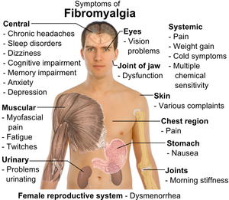
Fibromyalgia symptoms

Slide 8
What causes fibromyalgia?
Exact cause of FM is unknown and there is presently NO cure.
Current medical thought → FM is caused by a combination of physical, psychological and biological factors working together
Appears to be triggered by
physical trauma like surgery, injury, infection, giving birth
significant psychological stress like the breakdown of a relationship, death of a loved one, or abuse in childhood
There is evidence of the following causes:
Environmental factors
Genetics (Family History)
Depression disorders
Neuro-chemical imbalances
Brain abnormalities (i.e., problem with the processing of electrical signals in the brain) which results in altered pain perceptions

Slide 9
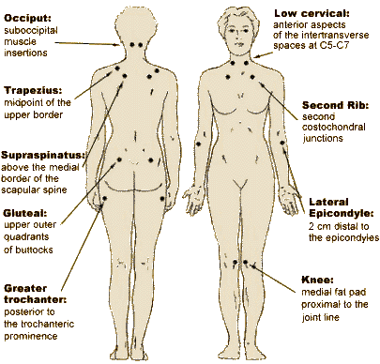
How was fibromyalgia originally diagnosed?
18-Tender Point Examination
No longer accepted as a reliable clinical finding and is not included in current diagnostic criteria.

Slide 10
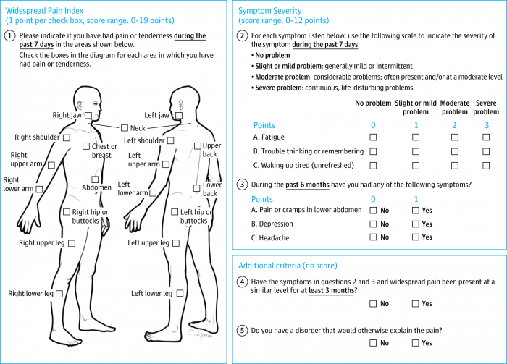
How is fibromyalgia diagnosed now?
ACR 2010 Diagnostic Criteria (modified in 2011, 2016)
Widespread Pain Index for past 7 days: identify pain/tenderness in 19 regions
Symptom Severity Scale (0-3) for past 7 days: fatigue, cognitive, sleep
Symptom Identification (0-1) for past 6 months: abdominal pain, depression, headache
All reported symptoms must have been present for at least 3 months
Combined WPI & SSS maximum score of 31, can self-report

Slide 11
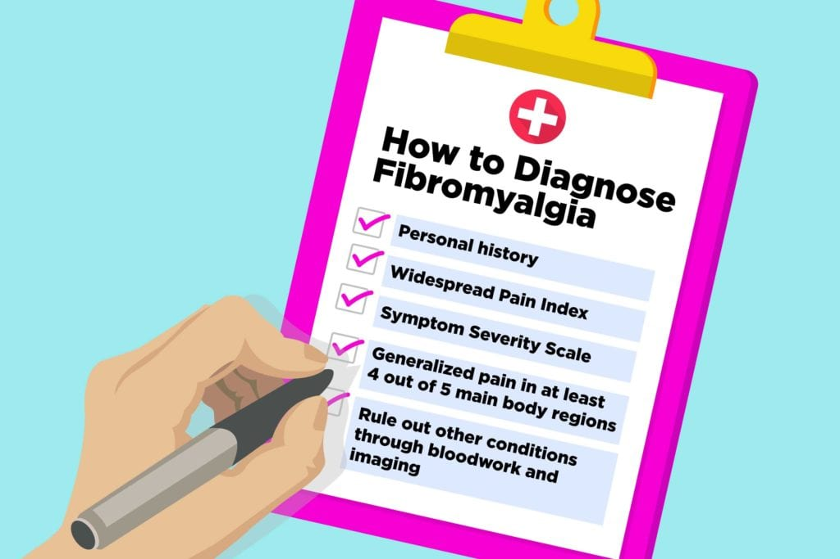
Where do I go to get a diagnosis?
Your Family Doctor for diagnosis and treatment
No blood test, lab or diagnostic test, or imaging study to confirm diagnosis, although these may be used to rule out other diseases
FM is no longer considered related to Rheumatology.
Currently, FM does not fall under any medical category/classification.
Some Facts:
FM affects between 2-4% of Canadians (760K-1.5M)
Most people with FM are women (80 to 90%)
Although painful, FM does not lead to permanent joint damage or deformity
People with chronic illnesses such as Myalgic Encephalomyelitis, Environmental Sensitivities, Rheumatoid Arthritis (RA), Osteoarthritis, Systemic Lupus Erythematosus (commonly called lupus) and Sjogren’s Syndrome can also have FM

Slide 12
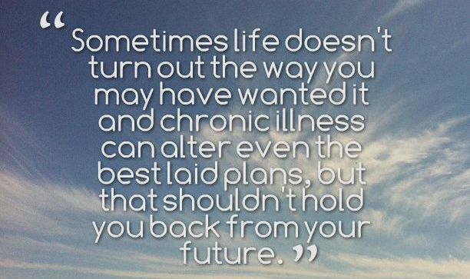
YOU HAVE BEEN
DIAGNOSED WITH FIBROMYALGIA
NOW WHAT?
Your New “Norm” is Living with Fibromyalgia –
a chronic, invisible, life-altering illness

Slide 13
HOW DOES FIBROMYALGIA LONDON GROUP SUPPORT ITS MEMBERS?
Led by facilitators with FM and other comorbidities, we offer:
Programs and Activities - focus on BODY + MIND + SPIRIT
Patient Education Opportunities - learn more about this complex, multi-systemic, invisible illness/disability.
Information Sharing - find out about community resources, supports like disability benefits and social services.
Socialization - Meet people who are going through a similar experience and journey as you, and who get it!
Build Up Your FM Survival Toolbox – coping strategies, equipment and aids
Volunteer Opportunities - gives you purpose, helps you grow, and provides you with a way to give back to community.
Stay Informed – regular email communications and updates, social media announcements, frequent updates to website

Slide 14
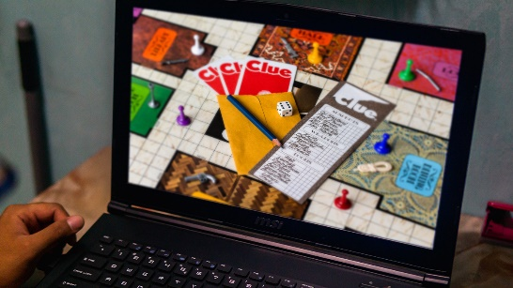
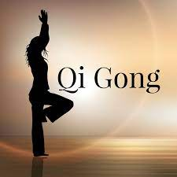
SOME OF OUR PROGRAMS & ACTIVITIES
Group Games
Fun & More
Seated
Yoga
Six Degrees Social
Conversations
virtually!
FREE ~ Members Only ~ Registration Required
to receive ZOOM link for each activity
Email: fmgroup.london@gmail.com or Call: 519-453-3198

Slide 15
PATIENT EDUCATION OPPORTUNITIES

Slide 16
HOW DOES ONE BECOME A MEMBER ?
A peer-led health and wellness support group for persons with fibromyalgia, including those newly diagnosed, regardless of where they live.
As we pride ourselves in being an inclusive group, we do welcome anyone who lives with a chronic illness or a comorbidity of FM.
Our membership fee of $15.00 per year (reduced from $20.00 pre-Covid19) to make it more affordable. This is our only source of funding to support our ongoing operational costs.
FLG is not a registered charitable organization, so we are unable to provide tax deductible receipts.
Payment can be made via e-transfer or by cheque.
Visit our website, www.fibrolondongroup.ca
Go to our MEMBERSHIP page. Read through the benefits of becoming a member and what we offer.
Fill out the online membership application and select which programs and activities you wish to participate.

Slide 17
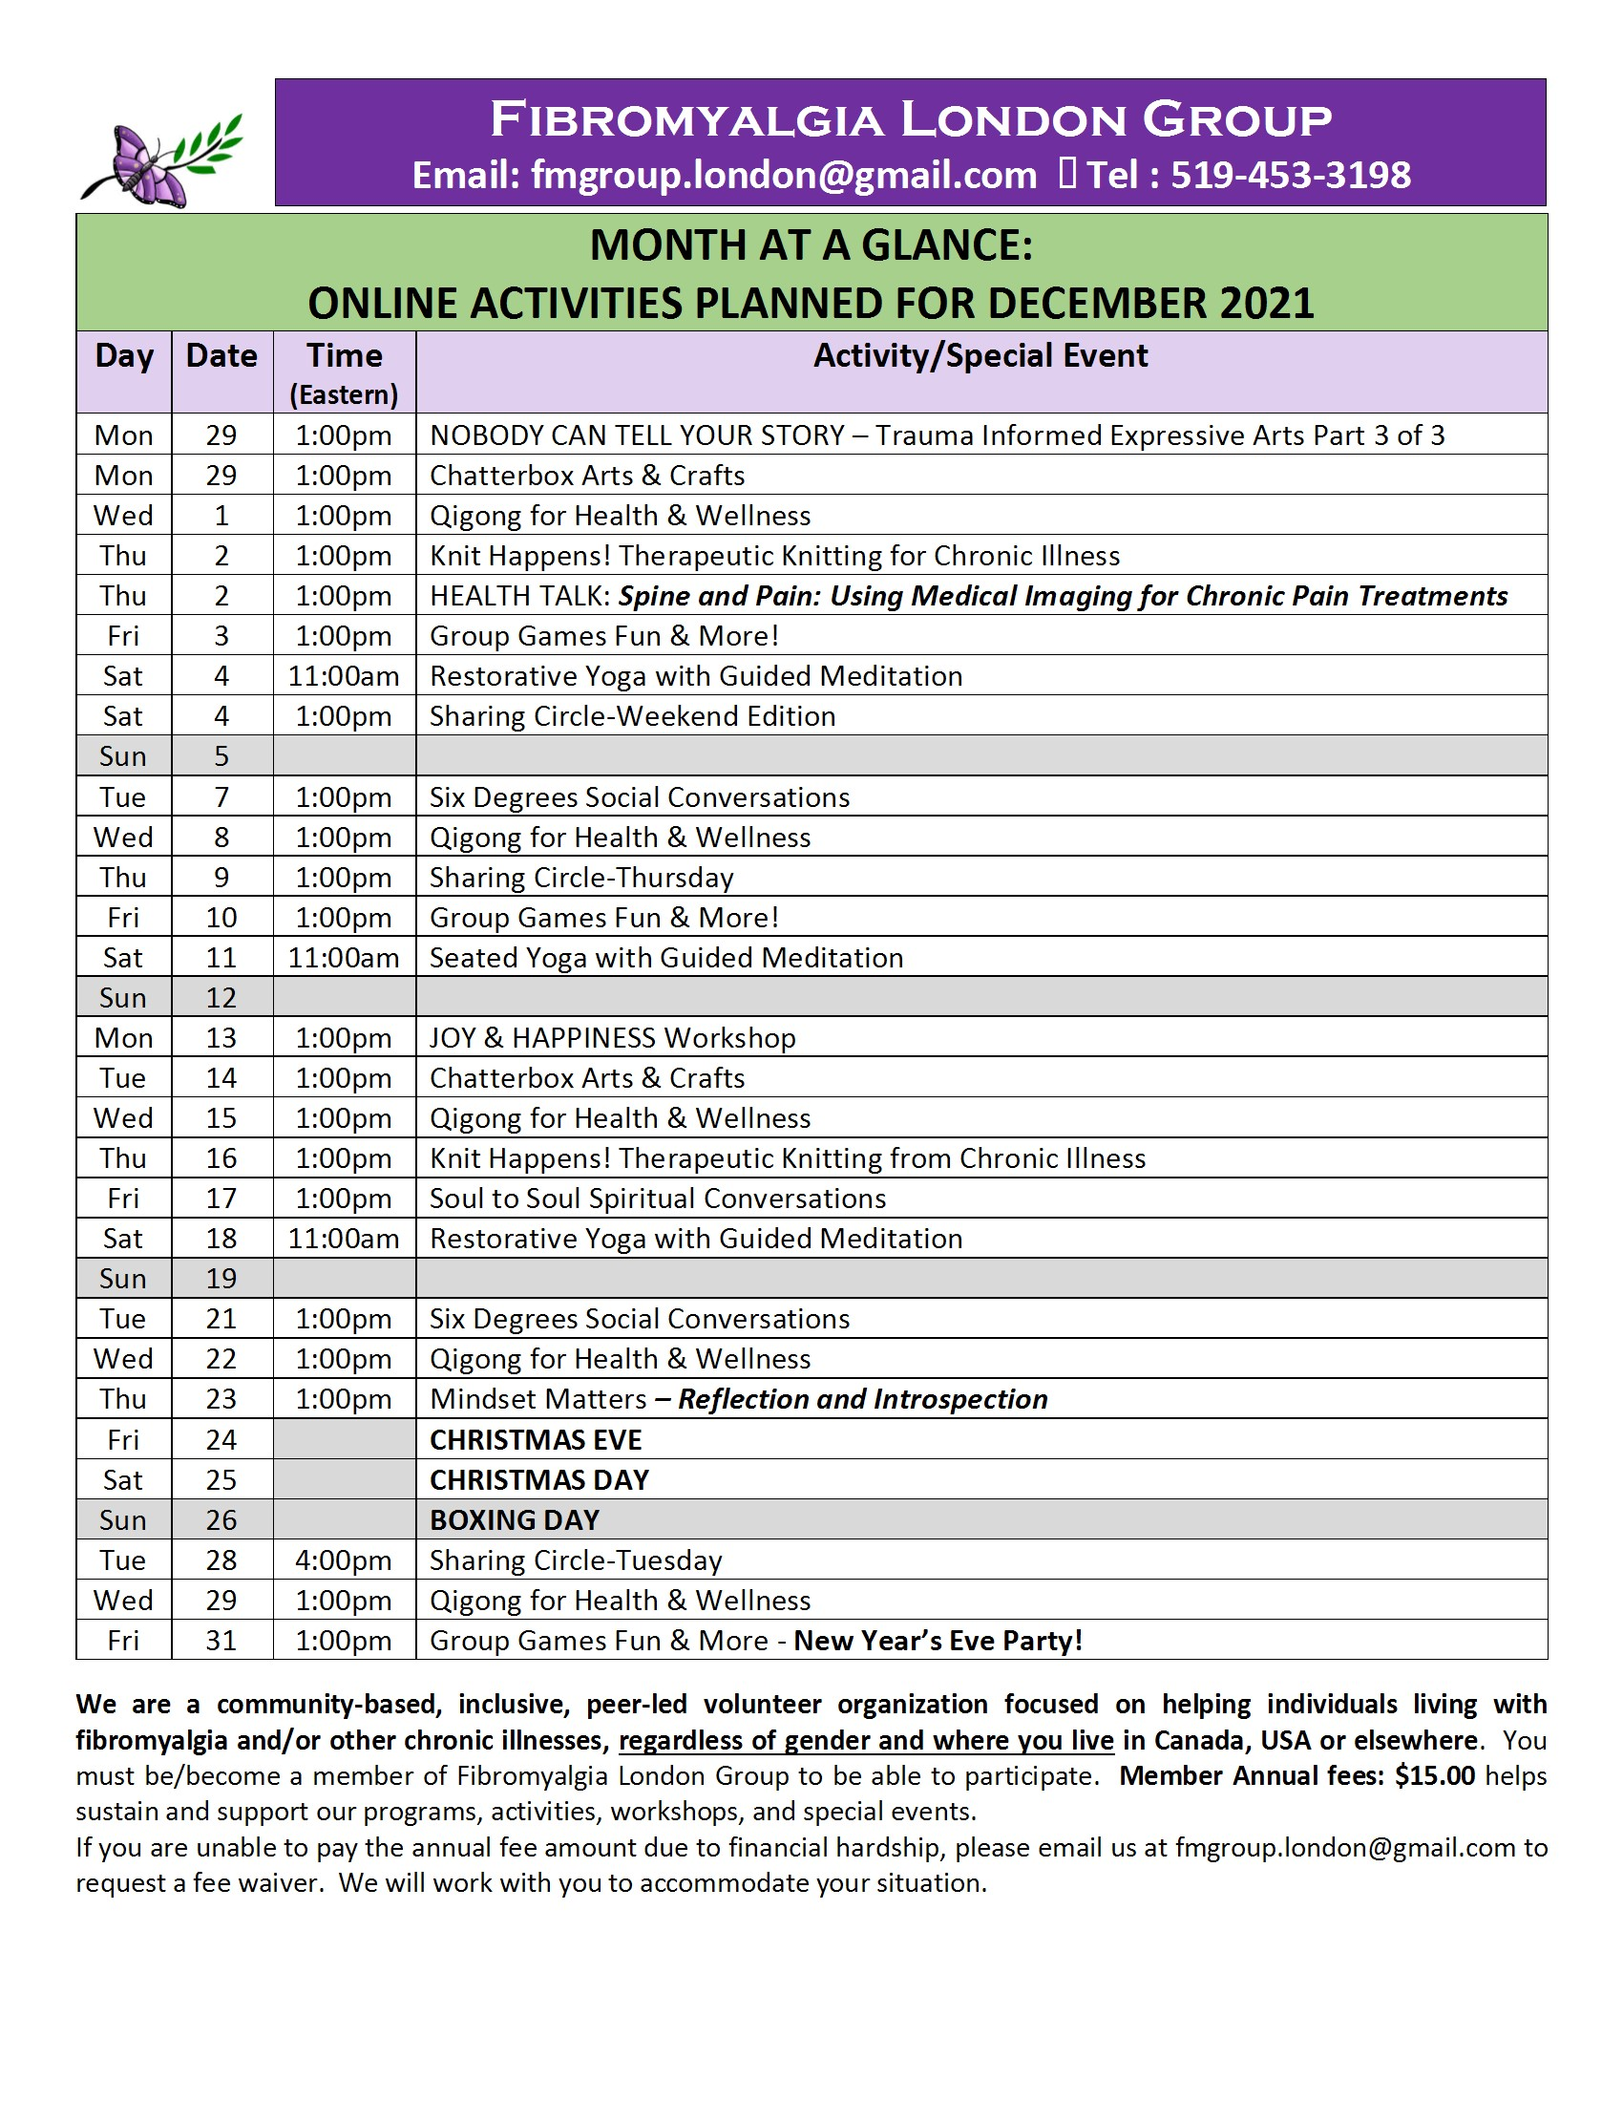
BE SURE TO CHECK OUT OUR MONTH-AT-A- GLANCE CALENDAR SENT
VIA EMAIL TO YOU EVERY MONTH AND POSTED ON SOCIAL MEDIA!

Slide 18
REFLECT AND
PONDER THIS
YOU HAVE A CHOICE

