Slide 1
Notes:
welcome

Slide 2


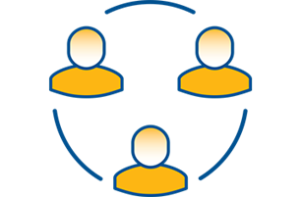
Mission
To invest in cutting-edge research, proactive advocacy and innovative solutions to deliver better health outcomes for people affected by arthritis
Research
Advocacy
Solutions
      Research Is Having A Positive Impact On Health Outcomes
          People With Or
          At Risk Of Arthritis
          Receive Timely & Effective Care
      People With Or
      At Risk Of Arthritis
      Are Knowledgeable and Empowered

Slide 3
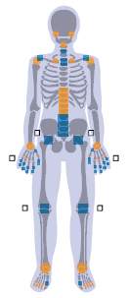
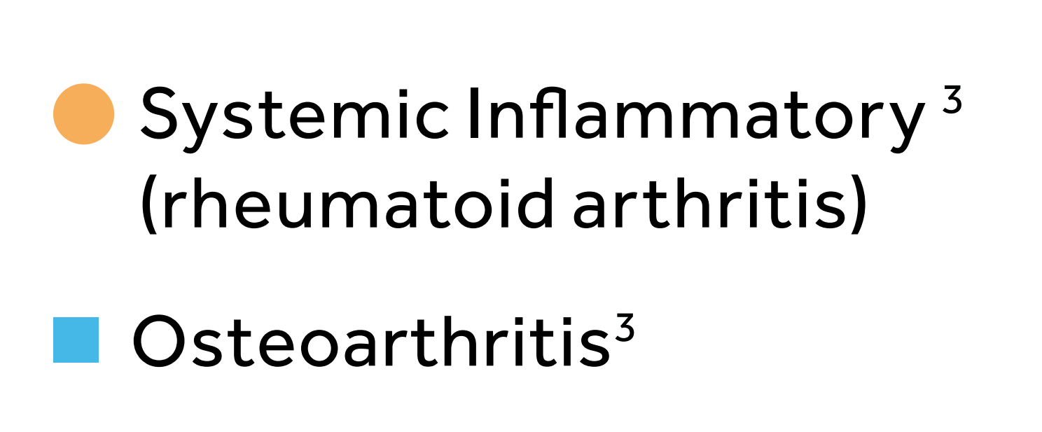
Inflammatory Arthritis vs Osteoarthritis
Reprinted with Permission from the Arthritis Alliance of Canada, the Centre for Effective Practice and the College of Family Physicians of Canada (June 2017). Osteoarthritis Tool: Canada: the Arthritis Alliance of Canada, the Centre for Effective Practice, the College of Family Physicians of Canada
Notes:
Over 6 million Canadians are affected by some form of arthritis – that's 20% of the Canadian population. There are over 100 types of arthritis – 2 major categories: Inflammatory and degenerative,
Inflammatory arthritis is AUTO-IMMUNE – the body attacks itself, specifically the synovium, the joint lining, and this causes inflammation which, which if untreated, can result in joint damage. The orange circles represent the joints most commonly affected by inflammatory arthritis.
It is really important that people with inflammatory arthritis be on disease modifying medications to control the inflammation and prevent joint damage.
People with RA can have OA changes as well.
The blue squares represent the joints most commonly affected by Osteoarthritis. Osteoarthritis is much more common than inflammatory arthritis and this is the one we will focus on today.

Slide 4
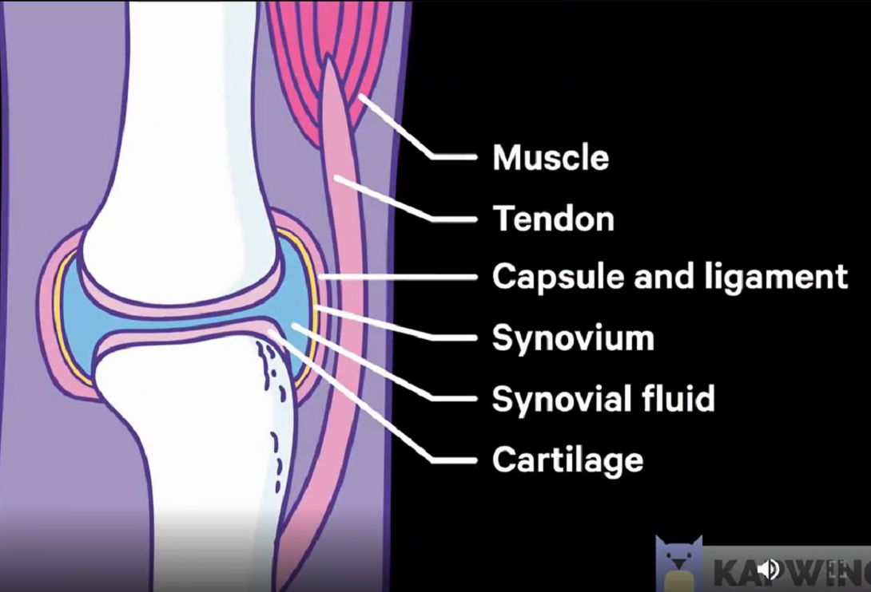
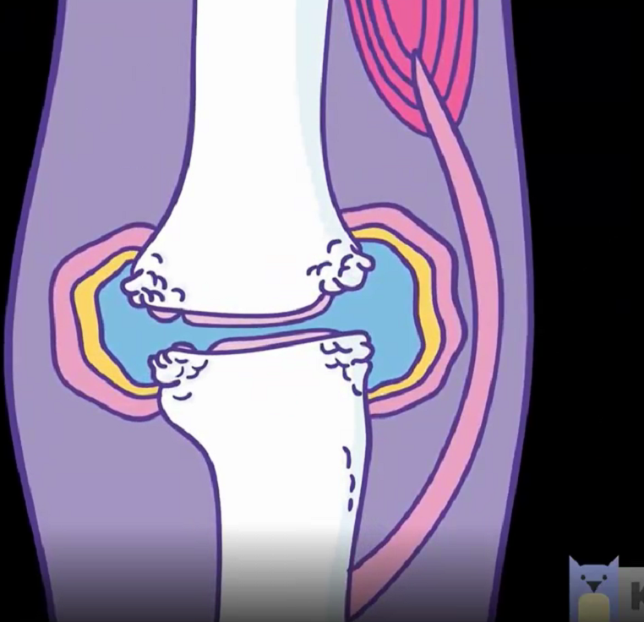
Joint
OA Joint
Versus Arthritis
Notes:
Now let’s talk about the anatomy of a joint and how Osteoarthritis changes it.
In the joint on the left, you can see that the cartilage (the covering on the end of the bones in pink) is very smooth and the joint has a contoured shape. This allows the joint to move effortlessly and pain free.​ The ligaments, capsule, tendons and strong muscles allow the joint to bend in the proper alignment.
In the OA joint on the right, there are changes. The cartilage has become roughened and less thick.
There is some mal-alignment because of the uneven change in the joint shape, which can also affect how the ligaments hold the bones in place.​
​
The shape of the joint changes because of extra bony growth called osteophytes and the contours are altered, affecting how much the joint can bend or straighten and it can cause limitations of motion and affect your hand function.​
​

Slide 5
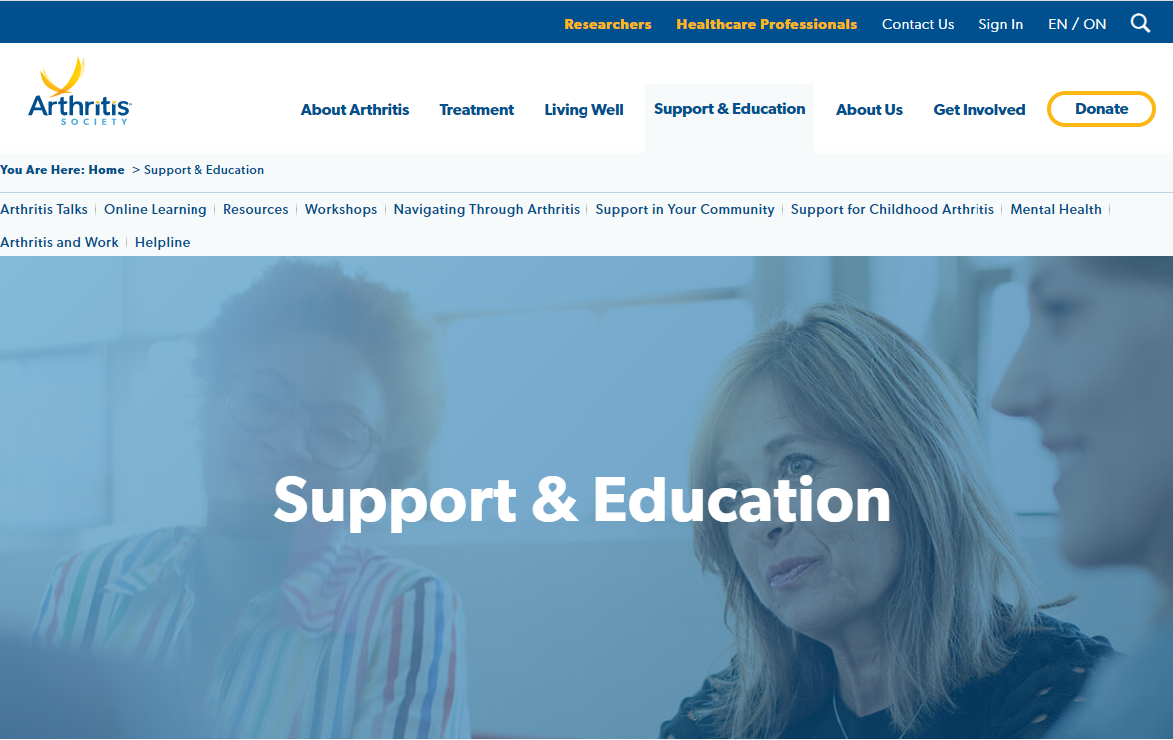

Notes:
The Arthritis Society has an extensive website with information about arthritis research, advocacy initiatives and a very large section to help you live well with your arthritis. It is a reliable source of information about arthritis treatment options in Canada;

Slide 6

www.arthritis.ca/support-education/online-learning
Notes:
The Arthritis Society website has online learning modules on a number of popular topics such as Medical Cannabis & Arthritis, Managing Chronic Pain, Overcoming Fatigue and Eating Well.
www.arthritis.ca/support-education/online-learning

Slide 7

Arthritis Rehabilitation and Education Program (AREP)
Education and support to help people learn to self-manage their arthritis
Notes:
www.arthritis.ca/support-education/

Slide 8
Arthritis Rehabilitation and Education Program (AREP)
OTs and PTs and Social Workers
Clinical Practice Skills for Inflammatory Arthritis program
Advanced Clinician Practitioner in Arthritis Care (ACPAC) therapists
Notes:
notes

Slide 9

Arthritis Rehabilitation and Education Program
Individual consultations:
telephone
video e-visits (OTN, Zoom)
in-person appointments
Notes:
Notes

Slide 10
Arthritis Rehabilitation and Education Program (AREP)
Educational virtual workshops (Zoom)
Evidence-based self-management strategies
Opportunity for patient interaction
Free of charge
Pre-register in advance:
arthritis.ca/events
Notes:
notes

Slide 11

Stay Active with Hip or Knee OA Virtual workshop
Strategies to manage OA symptoms
Patients who do not yet qualify for THR or TKR
arthritis.ca/events
Notes:
Virtual One three-hour session offered several times per month Strategies such as therapeutic exercise, physical activity, weight management, community and online resources

Slide 12
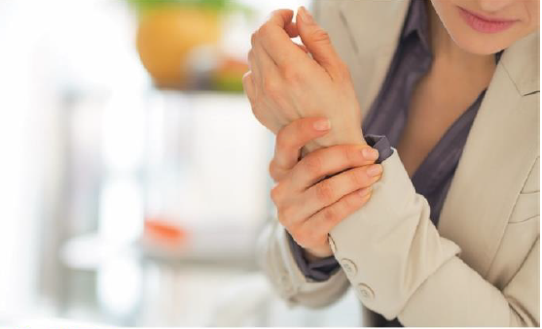
Taking Charge of your Inflammatory Arthritis workshop
Patients with RA or PsA
3 sessions
arthritis.ca/events
Notes:
Patients with RA or PsA can learn more about IA; strategies to manage symptoms, how to deal with social and emotional impact of IA, importance of physical activity, exercise, joint protection, healthy eating and online resources

Slide 13
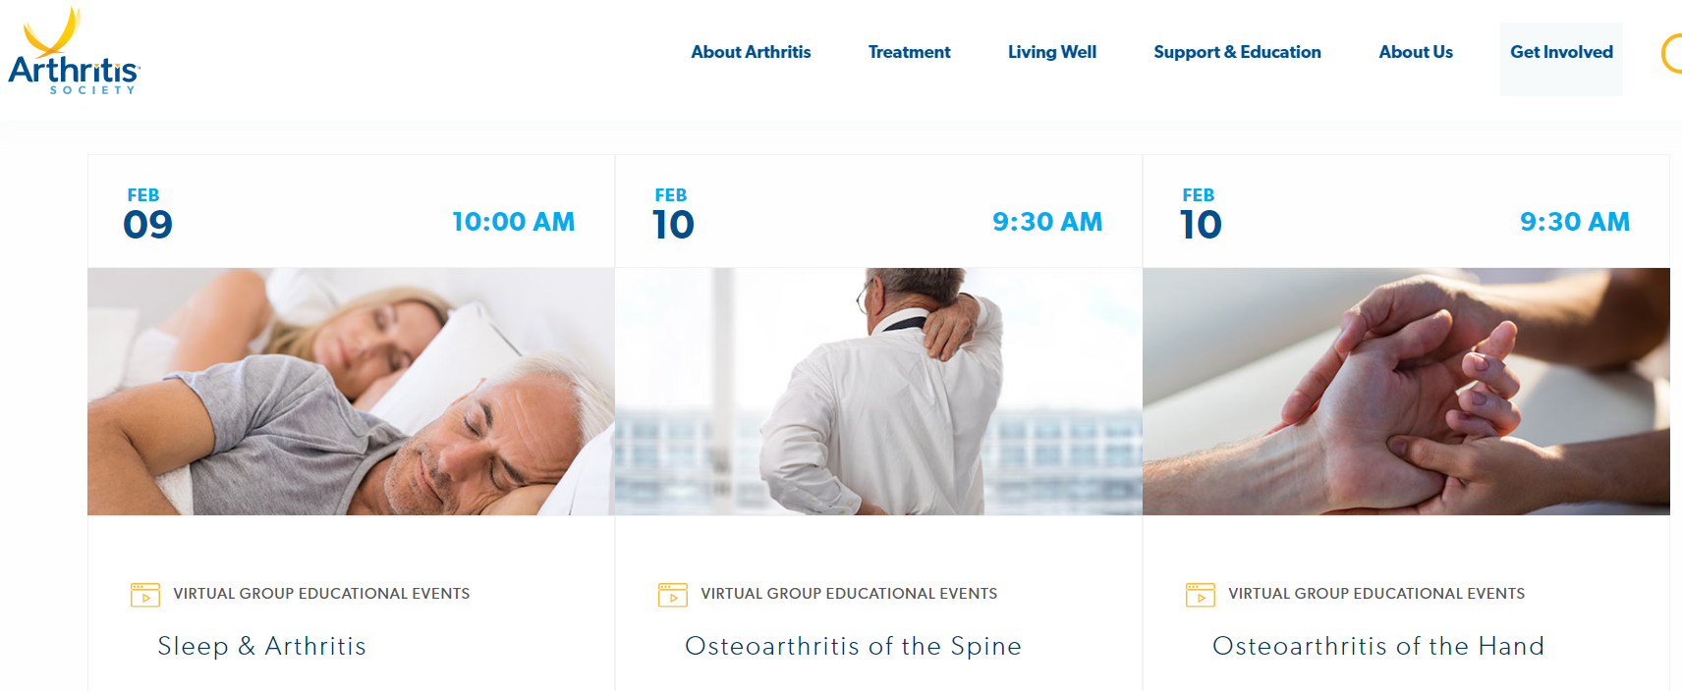
www.arthritis.ca/events
Notes:
The Arthritis Society offers free-of-charge virtual workshops on a number of topics such as Sleep & Arthritis, Osteoarthritis of the Spine and Osteoarthritis of the Hand. Visit our website: www.arthritis.ca/events to see our calendar of upcoming workshops and to register.

Slide 14

AREP Virtual Workshops
OA hand
OA spine
OA foot
Sleep better with arthritis
Mindfulness Meditation
Hypermobility / EDS
Fibromyalgia
Living well with SpA
arthritis.ca/events

Slide 15

Arthritis Society Webinars
Online Arthritis Talks webinars
Panel of rheumatologists
Latest research and treatments options
arthritis.ca/events
Notes:
Join the Arthritis Society and a panel of arthritis experts including Dr. Diane Lacaille, Dr. Paul Fortin and Dr. Hance Clarke for Arthritis Talks: Road to a Cure. This webinar will answer your questions about arthritis research, why certain research projects are chosen over others, why it often takes time to see results, why research costs as much as it does and what our expert panel is optimistic about on the horizon. Dr. Fortin will also provide an update on his exciting COVID-19 research project.
The webinar will help you learn:
The most important arthritis research advancements for arthritis patients
How long it takes to develop new treatments
Research on medical cannabis and its potential as an arthritis treatment
Research on COVID-19 and its effect on people with arthritis
Future treatments to expect over the next years
and more...

Slide 16
arthritis.ca/AREP
eFax or OCEAN platform
Online self-referrals
1-800-321-1433 ext 3307
Notes:
Because our services are funded by the Local Health Integration Network (LHIN) clients must have a valid Ontario Health Card and will only be charged for splints and equipment.
Can be referred by healthcare professional or self referral
1.Clients must have a confirmed or suspected diagnosis of arthritis and arthritis should be the primary presenting problem. We do not provide assessment/management for clients presenting with MSK pain or post-op joint replacement rehabilitation.
2.Referrals are triaged based on diagnosis, reason for referral, and availability of resources.
3.Major focus on inflammatory and peripheral joint arthritis. This includes conditions such as Ankylosing Spondylitis. Inflammatory arthritis referrals will be scheduled for a one-to-one comprehensive assessment and a treatment program will be developed. The treatment program might include group education.
4.Clients with a diagnosis of osteoarthritis are triaged to one of our virtual therapeutic education groups as available and/or to an individual assessment.
5.Clients with a diagnosis of fibromyalgia may be triaged to a virtual therapeutic education group or referred to other community programs.
Typically contact made within a few days to a week then approximately 2-4 weeks until appointment.

Slide 17

Case #1:
Osteoarthritis knees
Notes:
This is to provide you with a more concrete example of what we do when someone with OA knees comes to see us. We picked a knee assessment as this is quitecommon and allows us to outline what we do.

Slide 18
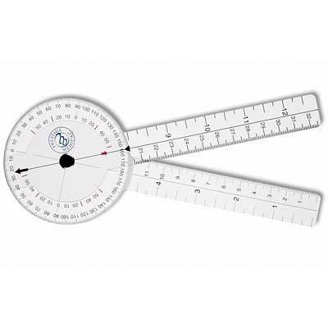
OA Knee Assessment
History
Current meds
Alignment and gait assessment
ROM and strength assessment
Functional tests (transfers, squat, balance)
Notes:
History: a summary of how the arthritis started and has been progressing, how has it been interfering with activities of daily living.
Meds: other health issues, this can give me insight into reason for flare i.e. are they taking meds properly/at all, if not why and does the Dr. know.
From the physical exam I can ask them more specifically what they may be struggling with. I will also find out what strategies they already have in place.

Slide 19
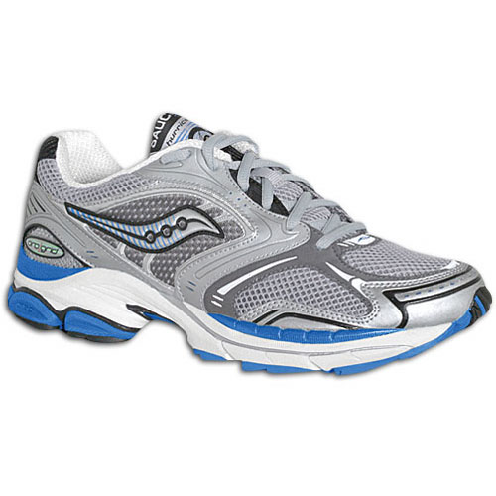
OA Education
Understand the diagnosis
Review medications & supplements
Joint protection
  Footwear
  Weight-loss
  Activity modification
Notes:
Joint protection: footwear, moderation, weight loss, cane, learn aggravating factors

Slide 20
OA Education
Equipment
  Cane vs walker
  Grab bars, tall toilet
  Railings
Pain management
  Joint protection
  Heat vs Cold
  Bracing
Notes:
Equipment: cane, walker, raised toilet, grab bars. Specific equipment and assistive devices are recommended and a list of vendors can be provided.
Application for funding for equipment (ODSP / Ottawa EHSS) can be made.
Pain Management: heat vs cold, braces, topicals, TENS unit can be loaned

Slide 21
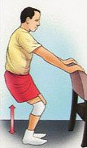
OA knees and exercise
Evidence: 2 hours of strengthening per week can significantly reduce pain and improve function
S. Skou and E. Roos; Good Life with osteoArthritis in Denmark (GLA:D™); BMC Musculoskeletal Disorders, Feb 2017
Notes:
https://bmcmusculoskeletdisord.biomedcentral.com/articles/10.1186/s12891-017-1439-y
Good Life with osteoArthritis in Denmark (GLA:D™): evidence-based education and supervised neuromuscular exercise delivered by certified physiotherapists nationwide
Søren T. SkouEmail authorView ORCID ID profile and Ewa M. Roos
BMC Musculoskeletal DisordersBMC series – open, inclusive and trusted201718:72
https://doi.org/10.1186/s12891-017-1439-y© The Author(s). 2017
Received: 13 September 2016Accepted: 31 January 2017Published: 7 February 2017

Slide 22
Good Life with osteoarthritis in Denmark (GLA:D™)
9,825 participants with hip and knee OA
education & supervised strength exercise
1 hour 2x/wk 6wks
Significant improvement pain & quality of life
improved physical function & physical activity
Reduced use of pain meds & sick leave
Results have been repeated in Canada
S. Skou and E. Roos; Good Life with osteoArthritis in Denmark (GLA:D™); BMC Musculoskeletal Disorders, Feb 2017
Notes:
Good Life with osteoArthritis in Denmark (GLA:D™): evidence-based education and supervised neuromuscular exercise delivered by certified physiotherapists nationwide
Søren T. Skou and Ewa M. Roos
BMC Musculoskeletal DisordersBMC series – open, inclusive and trusted201718:72
https://doi.org/10.1186/s12891-017-1439-y© The Author(s). 2017
Published: 7 February 2017
9,825 participants with hip and knee OA
education and supervised exercise twice per week for 6 weeks delivered by trained physiotherapists.
improved pain intensity and quality of life by 12.4 points and 5.4 points at 3 months, and 13.7 points and 9.4 points at 12 months, respectively. Furthermore, physical function and physical activity improved (only at 3 months), fewer patients took painkillers following the treatment, and fewer patients were on sick leave at 12 months following GLA:D compared with the year prior

Slide 23
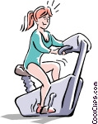
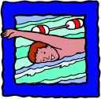
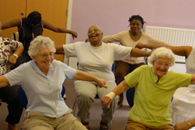
OA knees and exercise
Low impact exercise
Swimming
Bicycle
Notes:
The importance of regular / daily exercise is emphasized with patients and we help them to choose one which will fit into their lifestyle.
We have a pair of urban walking poles in our Ottawa office for our patients to try. A cane or walking poles can reduce stress on knees by 10 to 20%
Recommendation of community resources: walking clubs, cit of Ottawa community programs

Slide 24
Community Resources
Online resources
List of community pools
City run programs for low-impact exercise classes
GLA:D program
Walking clubs
Vendors
Notes:
We always discuss the benefits of pool exercise with our patients and we refer to local pool programs in their area.

Slide 25


Stay Active

Slide 26
Case # 2:
Rheumatoid Arthritis referral for splinting assessment
Notes:
This is to provide you with a more concrete example of what we do when someone with RA comes to see us. We picked a hand assessment as this is quite typical and allows us to outline what we do.

Slide 27
RA Hand Assessment
History (disease, social)
Current Medications
Joint Count
Damage, deformities
ROM, grip strength
Function
Notes:
History: a summary of how the arthritis started and has been progressing, how has it been interfering with activities of daily living.
Meds: other health issues, this can give me insight into reason for flare i.e. are they taking meds properly/at all, if not why and does the Dr. know.
From the physical exam I can ask them more specifically what they may be struggling with. I will also find out what strategies they already have in place.

Slide 28
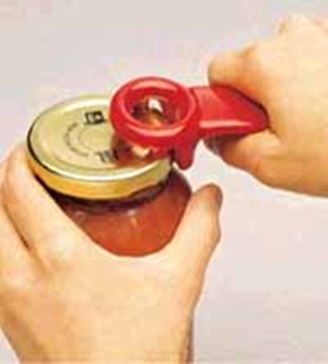
RA Education
Understand the diagnosis
Medications
Joint protection
Pacing
Pain management (heat, cold, exercise)

Slide 29
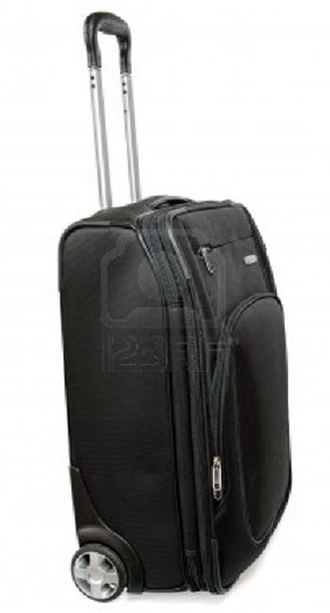

Joint protection

Slide 30
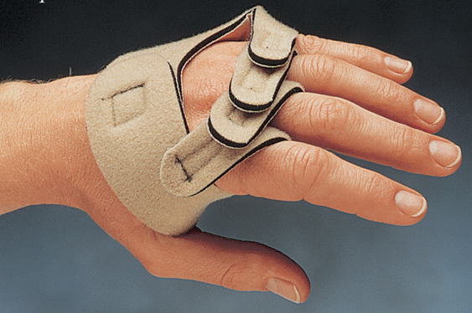
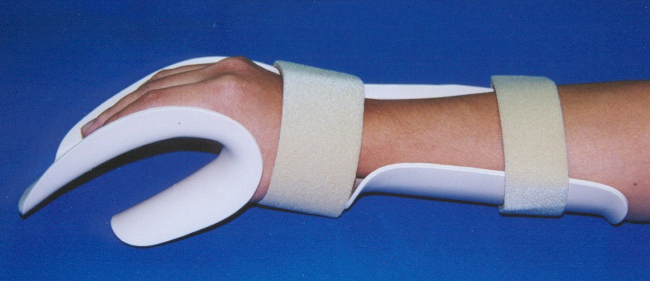
Supports for RA
Resting brace
Ulnar drift support

Slide 31
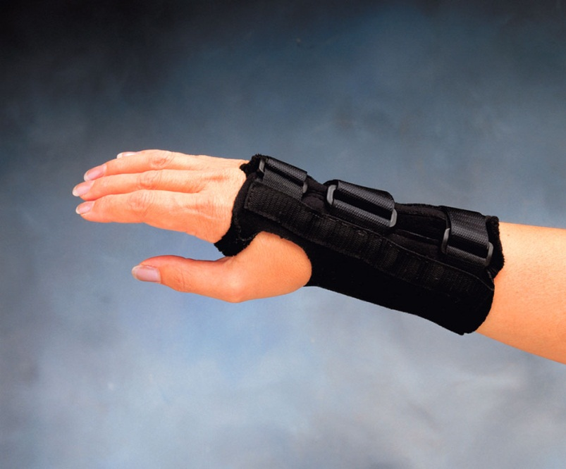
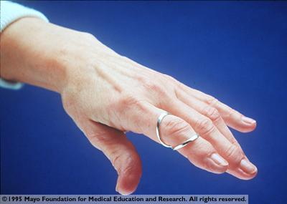
Supports for RA
Ring splint
Working wrist support

Slide 32
Social Work Role
Psychosocial assessment
Counseling support (listen, validate, normalize, goal setting)
Assist with communication / advocacy (family, employers, health professionals)
Community referrals
Notes:
Assessment undertaken to identify at risk areas
Counseling techniques vary – CBT, brief-solution focused therapy, crisis intervention -based on issues and client need
Communication - Advocacy people do not always want others to know about their condition, may fear they will feel pitied or “less than”
Some people will not ask questions of their health care team and leave feeling confused
Community referrals – wide vary – about as much as you could think of, again, dependent on client issues/need

Slide 33

For Example…
Financial
Ability to earn income reduced
Client can’t afford meds
Social Work role:
Support navigating government financial programs – ODSP, CPP Disability, Trillium
Connection to other community resources as needed – housing, CCAC
Notes:
Often our new clients have never been in a position to have to access the options available to them and so they are unsure where to start to even look for what might be available.
The application processes can be exhausting, frustrating and time-consuming. Some assistance with completing the forms, can go a long way to give clients the sense that they are moving forward.

Slide 34
Emotional Support
Depression – a natural part of the grieving process
Usually not clinical in nature
No/little motivation for treatment; little joy in daily life
May be unable to absorb medical advice or explanation
Notes:
Depression – not usually clinical but some instances of suicidal ideation requiring intervention
-presents with flat affect, emotionally labile, no eye contact, unfocussed, unable to see future
-I will ask people…are you doing anything that is fun?

Slide 35

Arthritis Rehabilitation and Education Program
Home visits

Slide 36
In conclusion...
Main Goal
Work with people with arthritis as they learn to adapt to living with a chronic illness

