Slide 1
THANK YOU FOR JOINING US
Please note:
Today's presentation is in a webinar format which has been chosen for its enhanced security features
All attendees' cameras and chat features have been disabled
Please use the Q&A button to submit questions
Questions will be addressed at the end of the presentation

Slide 2
Annual General Meeting March 26, 2022

Slide 3
Agenda
Welcome
The 2020 – 2021 Year in Review
Looking Forward to 2021 – 2022
Thank you to our Volunteers
The Board 2021 - 2022
Special Volunteer Presentations
Donna Chu Award
Research Update - Dr. Murray Urowitz
Tribute to Dr. Murray Urowitz
Questions for the Board
Adjournment

Slide 4
2021 Review & Annual General Meeting

Slide 5
What We Do
Our Mission
Lupus Ontario’s mission is to provide vital support, education, awareness, advocacy and research through the fundraising efforts of our staff and volunteer community to help those with lupus live longer, healthier and better lives.
ADVOCACY

Slide 7
Executive Committee
Executive Committee​
Established long-term strategic goals to support our Vision and Mission. Created an Advocacy Committee to achieve goals.
Improve medical care access in Ontario especially outside major urban centres. This includes access to rheumatologists, other supporting specialists, treatment centres and medical facilities such as labs, clinics and hospitals.
Improve access to medications/treatments especially new biologics that are being developed.
Support research initiatives in lupus areas that are currently not being explored, such as CNS.

Slide 8
Advocacy
Following the Government declaration of May 10 as Lupus Awareness Day in the Province of Ontario, the Advocacy Committee has been focused on building relationships with other organizations who are working to improve the lives of patients with inflammatory arthritis conditions.
This will give us a stronger voice when we petition the government and other institutions for better supports and services for the lupus community.

Slide 9
Support Services
Lupus Ontario made a difference in the lives of patients:
We have seen growth in our on-line ZOOM support group meetings. These meetings allow members the opportunity to meet with other lupus patients to share concerns and to receive education. Our support groups have grown from one active prior to the pandemic to four at the present time. We have set up a separate email for Support requests: support@lupusontario.org.
Counselled on average 7 newly diagnosed patients per month as well as response to daily emails requiring general information and support

Slide 10
Education
Education kits mailed to those without email.
Education kits emailed and they can be downloaded from the website.
Many new educational presentations and webinar videos have been added on our website
Monthly/Bi-Monthly webinars are continuing this year. Normally 30-60 people attend. If someone cannot attend at the time of the webinar, it is posted on the website for viewing at any time.
Lupus Ontario Podcast was launched last year and there are many interesting topics for you to listen to.
Education

Slide 11
Public Awareness
Social Media
We continue to increase our followers on all our Social Media platforms
May Lupus Awareness Month
Ran a very successful awareness campaign with several media interviews including Sirius Radio, Mississauga Talk Show, Bradford
Podcasts
We began creating podcasts on various lupus related topics.
Our followers are steadily increasing, and we are reaching people in many countries around the world. Thank you, Brent Leonard, Joy Phillips, Meghan Wynne and Sara Ramnarine, for starting this very successful initiative!
Lupus Link Newsletter
Monthly digital newsletters to our members. For those requiring print, four newsletters each year are mailed.
Public Awareness

Slide 12
Governance
Governance
The Governance Committee focused on
Working with the Committees to establish a Terms of Reference which clearly outlined the purpose of each committee
Updating our policies to ensure they comply with current legal requirements
Succession planning for the Board and an assessment of Board member satisfaction and overall effectiveness

Slide 13
Fund Development
Focus was increased on sponsorship opportunities, grants and donor management including experience and stewardship
Two new online fundraising platforms have been engaged to allow for the increase in online donor engagement and online events
Virtual Walk for Lupus Ontario exceeded goal and raised over $89,000
First grant (pharmaceutical) was secured for the Geoff Carr Fellowship
Lupus Ontario's web site was updated to include fundraising/event information and sponsor recognition
Donor communication was switched to Mailchimp to allow better management
Fund Development

Slide 15
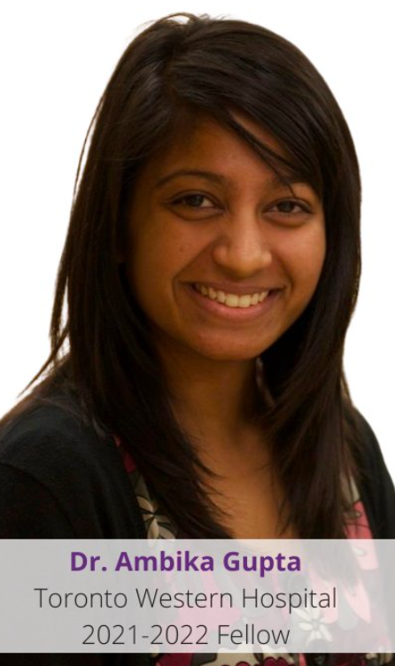
Geoff Carr Fellowship
Congratulations to Dr. Ambika Gupta, who studied at Toronto Western under the supervision of Dr. Touma.
Dr. Gupta’s research topic was on lupus nephritis. There was an article on her research in the February 2021 newsletter.
Dr. Gupta is now practising at the Trillium Health Centre in Mississauga.

Slide 16
Lupus Ontario Anne Matheson Biobank
Dr. K. Tselios, a former Geoff Carr Fellow, is starting a Biobank at McMaster University
The goal is to collect samples from patients at the Hamilton lupus clinic that can be used to further lupus research.
Lupus Ontario is honoured to be providing the initial funding required to establish and operate the biobank for three years.
The Biobank is named after Anne Matheson, Past President of Lupus Ontario who devoted countless hours to supporting lupus patients and their families in the Hamilton area.

Slide 17
Clinic Funding Ottawa London Hamilton Toronto Western SickKids Mount Sinai
In 2021, we were very pleased to be able to increase our funding to 6 accredited Ontario Lupus Clinics for a total of $30,000.
All the clinic funding monies were used to keep research data bases up to date.

Slide 19
Financial Results - Summary
Net Income | September 30, 2021 | September 30, 2020
Receipts Expenses | $583,465 283,644 | $836,307 285,341
Increase in Receipts over Expenses | $299,821 | $550,966

Slide 20
Financial Results - Receipts

Slide 21
Financial Results - Expenses

Slide 23
Looking Forward - Virtual Office
We are going virtual! The Lupus Ontario physical office is closing to dedicate more funds to research, public awareness, advocacy, support and education.
Our mailing address is:
285 Taunton Road East, Suite 4438
Oshawa, ON L1G 3V2
Our telephone and email address remains the same.

Slide 24
Looking Forward - 2022 Events
The Italian Dinner, Dance and Silent Auction fundraiser is back for 2022. The event is being held virtually with a Silent Auction and Mystery Bag sales from March 14th to the 31st.
Registration for the Walk for Lupus Ontario, our largest fundraiser will open on April 4th. The event will be held both in person and virtually as a hybrid event this year.
We will be raising awareness and funds through the annual World Lupus Day Campaign starting in May.
Our first ever Golf Day will be held on June 25th
Lupus Ontario is participating in the TCS Waterfront Marathon (formerly the Scotiabank Marathon) on October 16th both as a team and as one of the official charities.

Slide 25
2021 – 2022 Initiatives
Advocacy
Continue establishing partnerships with similar organizations to have a larger group representation.
Gather patient input through questionnaires and focus group meetings in order to provide input to Government evaluations of new lupus treatments
Work with the Ontario Rheumatology Association and others on improving access to care in Ontario
Governance
Review Bylaws to ensure compliance with updated Ontario legislation for not for profits
Continue to review all Lupus Ontario policies

Slide 26
2021 - 2022 Initiatives
Public Awareness and Education
Relaunch of the Lupus Ontario Health Symposium!
2022 will see the return of the Symposium in a virtual format, with a hybrid symposium for 2023.
Interactive infographic illustrating the impact Lupus has on various organ systems, as well as refresh of the Lupus Facts Booklet.
Translate educational materials to French to better serve the Francophone Community.

Slide 27
2021 – 2022 Initiatives
Support Services
We are hoping to launch the Windsor Support Group later this year
The goal for the Support Group is to return to limited in-person meetings/social events
We are currently seeking a facilitator to start a Mississauga Group
Online will continue for all the groups. In other communities, members can call the office or email the support team at support@lupusontario.org
Please join us Online on May 10 for Lupus Ontario’s 1st World Lupus Day Celebration with guest speaker Dr. Gupta. There will be live entertainment and trivia.

Slide 28
Thank You to Our Volunteers

Slide 29
Volunteers
Volunteers
Volunteers are the life blood of our organization. We would not exist without your dedication and commitment.
You help us with:
Public Awareness
Advocacy
Governance
Finance
Education
Fundraising
Support Groups
Administration
Board of Directors
We sincerely thank you for all that you do!

Slide 30
Volunteers
Volunteer | Role / Committee
Sara Ramnarine | Support and Education / Young Adults
Rupinder Sandhu | Support and Education
Cathy Ferren | Support and Education
Meghan Wynne | Support and Education
Laura Piccione | Durham Support Group Facilitator
Beth Beaven | Ottawa Support Group Facilitator
Joy Phillips | Young Adults Social
Julie St. Georges | Ottawa Support Group Facilitator
Michelle Bruxer | Support and Education / Facilitator
Arschna Rajasir | Support and Education
Kiah Reid | Support and Education

Slide 31
Volunteers
Volunteer | Role / Committee
Emma Neary | Dance and Medicine
Katie Healey | Dance and Medicine
Joni Waiser | Ottawa Door to Door Campaign
Gloria Checkley | Ottawa Door-to-Door
Brenda Cardillo | Ottawa Door to Door Campaign
Tom Koor | World Lupus Day Research Campaign
Carolyn Pancham | Newsletter

Slide 32
2021 Walk for Lupus Organizers
Location | Organizer
Durham | Laura Piccione, Sandra Williams Reid
Toronto | Linda Keill, June Alikhan
Ottawa | Brynn Clark
Mississauga | Rupinder Sandhu
Vaughan | Yadi Castro, Sabrina Dussin
North Simcoe | Heather Knoll
Hamilton | Kevin McGill
St. Catharines | Allison Doucet
Grey Bruce | Jillian Cooper
Muskoka | Cathy Ferren
Windsor | Riley Desjarlais
Woodstock | Jan Ropp
Kawartha Lakes | Michelle George
Haliburton | Denise Woods
Kapuskasing | Roxanne Vandal
Richmond Hill | Siraj Mehdi
Sudbury | Paulette Macdonald

Slide 33
Board of Directors 2020 - 2021
Title | Name | Committee
President | Linda Keill | Fund Development, Executive Committee, Finance, Governance, Advocacy
Vice President | June Alikhan | Fund Development, Executive Committee, Finance, Governance, Advocacy
Treasurer | Siraj Mehdi | Finance, Fund development, Executive Committee
Secretary | Kuljit Bhogal | Governance
Director at Large | Brynn Clark | Advocacy, Public Awareness, Executive Committee
Director at Large | Cheryl Gajadhar | Fund Development
Director at Large | Sandra Williams-Reid | Support and Education, Executive Committee
Director at Large | Jillian Cooper | Public Awareness, Executive Committee
Director at Large | Joseph Braithwaite | Fund Development, Executive Committee
Director at Large | Faraz Islam | Fund Development
Director at Large | Uzair Jalil | Governance, Executive Committee
Director at Large | Brent Leonard | Support and Education
Thank you to the Board Members who will be leaving or have left the Board this year:
Joseph Braithwaite
Faizan Bari
Kuljit Bhogal

Slide 34
Thank You to our Office Staff
THANK YOU to Karen Furlotte, Martina Whittick, and Hajra Batool for their dedication and commitment.
Jeremy Houston left Lupus Ontario in October, 2021. We thank him for all his work over the past year.
Sahara Mehdi worked with us over the summer of 2021 on our Social Media team. We thank her for her contribution and wish her all the best for her year at school.

Slide 35
The Board for 2021-2022

Slide 36
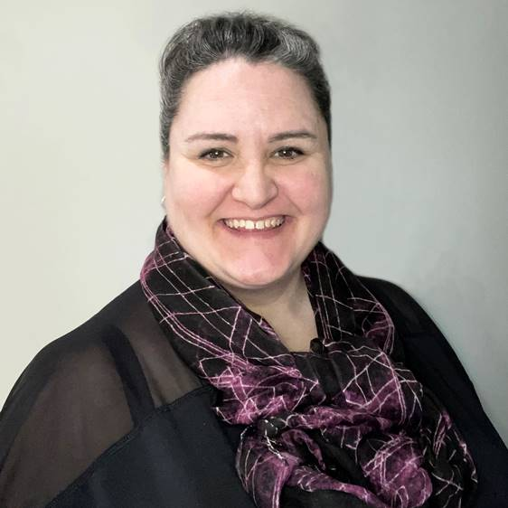
Meet Your New Board Member, Lisa Bilodeau
Prior to her diagnosis of SLE and Sjogren’s in 2016, Lisa​ spent 20 years in the Advertising & Marketing industry​ working on many top-level brands. She worked with a diverse​ range of creative and client teams.​
Lisa is looking forward to bringing her marketing and​ communication experience to the Public Awareness​ Committee, promoting Lupus Ontario’s mission through ​advocacy, education, and awareness.​
Living in Burlington, Lisa also volunteers in her community as a​ Little Free Library steward promoting literacy, and with 100​ Women Who Care Burlington, supporting and promoting local​ charitable organizations.​

Slide 37
Board of Directors Slate
Nominee | Position
Elected for a 2 year Term
Brynn Clark | Director at Large
Sandra Williams Reid | Director at Large
Lisa Bilodeau | Director at Large
One Year Remaining in Their Term
Linda Keill | President
June Alikhan | Vice President
Siraj Mehdi | Treasurer
Cheryl Gajadhar | Director at Large
Faraz Islam | Director at Large
Uzair Jalil | Director at Large
Brent Leonard | Director at Large
Jillian Cooper | Director at Large

Slide 38
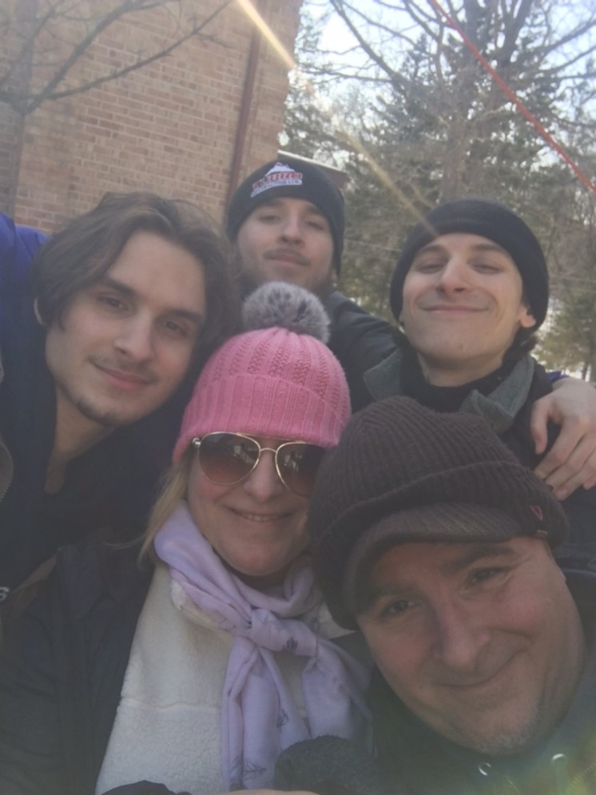
Donna Chu Award
The Donna Chu award, established in 1985 in memory of the late Donna Chu, is presented annually, in recognition of outstanding achievement, contribution, dedication or special service to Lupus Ontario.
The 2021 winner is Sabrina Dussin

Slide 39
Donna Chu Award
Sabrina started volunteering for Lupus Ontario in 2016 when she helped with set up for the Italian Dinner Dance. Being the parent of a child diagnosed with lupus, Sabrina wanted to get involved in spreading awareness and raising money for lupus research.
Since 2018, Sabrina has been the Chair of the Italian Dinner Committee. Over this time, the event has grown into a gathering of over 500 people and has netted Lupus Ontario over $125,000 for education, research, and support. The event has also attracted an increased involvement of provincial and local politicians and planted the seeds for the Province of Ontario officially recognizing Lupus Awareness Day on May 10th.
In 2021, Sabrina was co-coordinator for the Vaughn Walk for Lupus and this year she is Co-chair of a Virtual Italian Dinner Event featuring her very popular Mystery bags and an on-line Silent Auction.

Slide 40
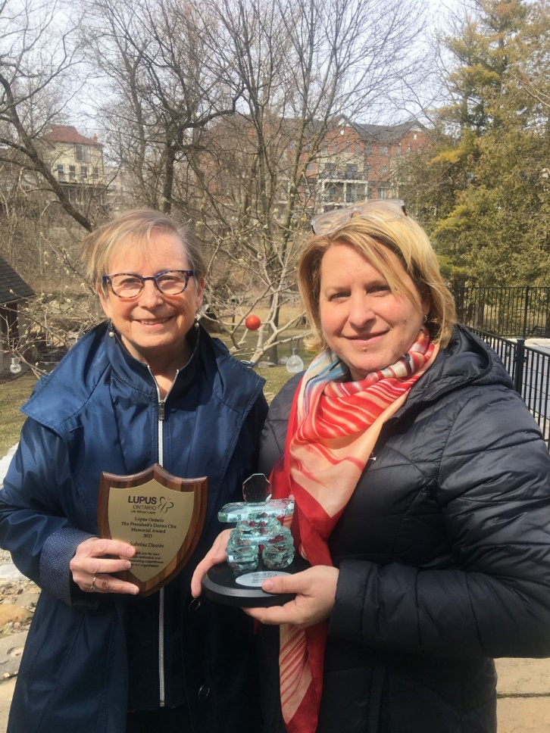
Donna Chu Award
Thank you, Sabrina, for all you do to increase lupus awareness and to raise funds for lupus research.
You are an inspiration to us all!

Slide 41
Lupus Research Update Dr. Murray Urowitz

Slide 42
Questions & Answer Session -With Dr. Urowitz

Slide 43
Dr. Urowitz Tribute

Slide 45
Questions & Comments for the Board

Slide 46
Thank you for attending!

